Slide 1
Priority Queues (Heaps)
Sections 6.1 to 6.5

Slide 2
Priority Queues
Regular queue supports
First In, First Out
Enqueue(): add a new element
Dequeue(): remove oldest element in queue
Data structure supports
Insert(): add a new element
deleteMin(): delete minimum element in priority queue

Slide 3
Applications of Priority Queues
In Operating Systems
Shortest Job First process scheduling
In Simulators
Scheduling the next event (smallest event time)
In essence
Any event/job management that assign priority to events/jobs
Greedy algorithms
Ones that operate by repeatedly finding a minimum

Slide 4
Priority Queue Implementation
Implemented as adaptor class around
Linked lists
O(N) worst-case time on either insert() or deleteMin()
Binary Search Trees
O(log(N)) average time on insert() and delete()
Overkill: all elements are sorted,
However, we only need the minimum element
Repeated deleteMin operations deplete the left subtree(s)
Heaps
This is what we’ll study and use to implement Priority Queues
O(logN) worst case for both insertion and delete operations

Slide 5
Partially Ordered Trees
A partially ordered tree (POT) is a tree T such that:
There is an order relation <= defined for the vertices of T
For any vertex p and any child c of p, p <= c
Consequences:
The smallest element in a POT is the root
No conclusion can be drawn about the order of children

Slide 6
Binary Heaps
A binary heap is a partially ordered complete binary tree.
The tree is completely filled on all levels except possibly the lowest.
In a more general d-Heap
A parent node can have d children
We simply refer to binary heaps as heaps
root
4
3
2
1
0

Slide 7
Vector Representation of Complete Binary Tree
Storing elements in vector in level-order
Parent of v[k] = v[k/2]
Left child of v[k] = v[2*k]
Right child of v[k] = v[2*k + 1]
root
R
l
r
ll
lr
rl
rr
1
2
3
4
5
6
7
R
l
r
ll
lr
rl
rr

Slide 8
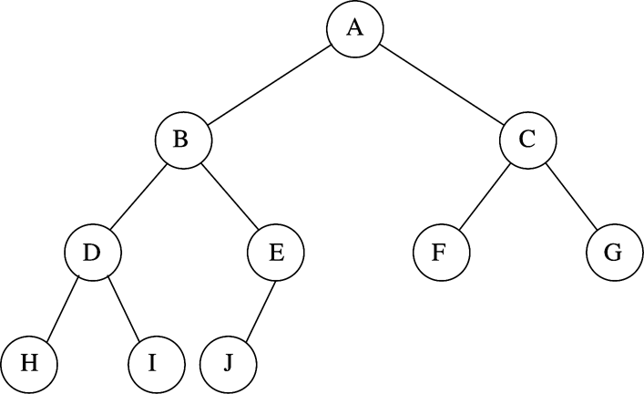
Heap example
Parent of v[k] = v[k/2]
Left child of v[k] = v[2*k]
Right child of v[k] = v[2*k + 1]

Slide 9
Examples
Which one is a heap?

Slide 10
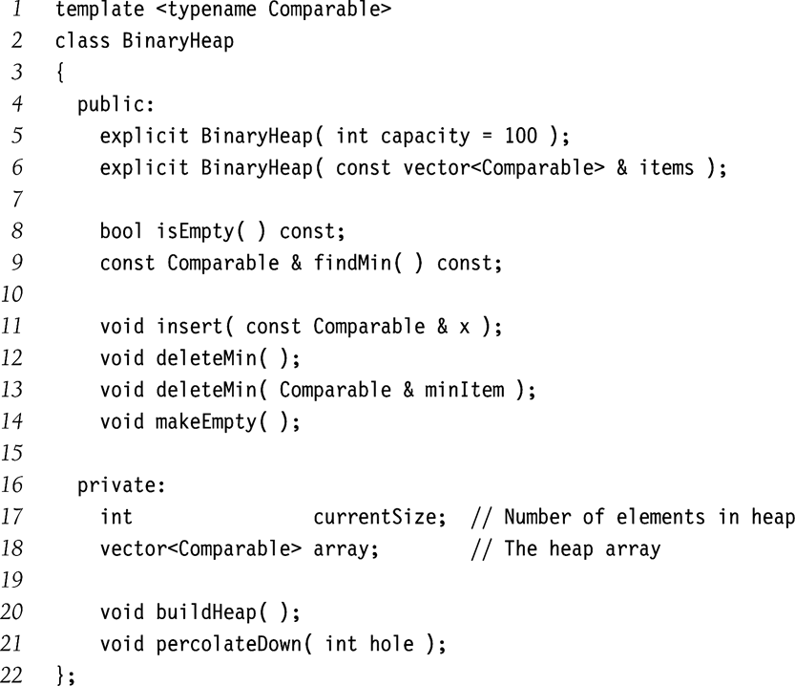
Implementation of Priority Queue (heap)

Slide 11
Basic Heap Operations: insert(x)
Create a hole at next leaf (empty)
// Repair upward
Repeat
Locate parent
if POT not satisfied (should x inserted in the hole)
Sliding parent element to hole
else
Stop
Insert x into hole

Slide 12
Insertion Example: insert(14)
(1)
(2)
(3)
(4)

Slide 13
Implementation of insert
/**
* Insert item x, allowing duplicates.
*/
void insert( const Comparable & x )
{
if( currentSize == array.size( ) - 1 )
array.resize( array.size( ) * 2 );
// Percolate up
int hole = ++currentSize;
Comparable copy = x;
array[ 0 ] = std::move( copy ); // for terminating the following loop
for( ; x < array[ hole / 2 ]; hole /= 2 )
array[ hole ] = std::move( array[ hole / 2 ] );
array[ hole ] = std::move( array[ 0 ] );
}

Slide 14
Basic Heap Operations: deleteMin()
Delete the root element
// root becomes a hole
// Must move last element (last leaf) to somewhere
Let y be the last element (rightmost leaf node)
Repeat
find the smaller child of the hole
if POT not satisfied (should y inserted in hole)
Sliding smaller child into hole
else
Stop
Insert y into hole

Slide 15
deleteMin() example

Slide 16
deleteMin() Example (Cont’d)

Slide 17
Implementation of deleteMin()
/ * Remove the minimum item.
* Throws UnderflowException if empty. */
void deleteMin( )
{
if( isEmpty( ) )
throw UnderflowException{ };
array[ 1 ] = std::move( array[ currentSize-- ] );
percolateDown( 1 );
}
/ * Remove the minimum item and place it in minItem.
* Throws Underflow if empty. */
void deleteMin( Comparable & minItem )
{
if( isEmpty( ) )
throw UnderflowException{ };
minItem = std::move( array[ 1 ] );
array[ 1 ] = std::move( array[ currentSize-- ] );
percolateDown( 1 );
}

Slide 18
Implementation of deleteMin()
/**
* Internal method to percolate down in the heap.
* hole is the index at which the percolate begins.
*/
void percolateDown( int hole )
{
int child;
Comparable tmp = std::move( array[ hole ] );
for( ; hole * 2 <= currentSize; hole = child )
{
child = hole * 2;
if( child != currentSize && array[ child + 1 ] < array[ child ] )
++child;
if( array[ child ] < tmp )
array[ hole ] = std::move( array[ child ] );
else
break;
}
array[ hole ] = std::move( tmp );
}

Slide 19
Constructor
Construct heap from a collection of item
How to?
Naïve methods
Insert() each element
Worst-case time: O(N(logN))
We show an approach taking O(N) worst-case
Basic idea
First insert all elements into the tree without worrying about POT
Then, adjust the tree to satisfy POT

Slide 20
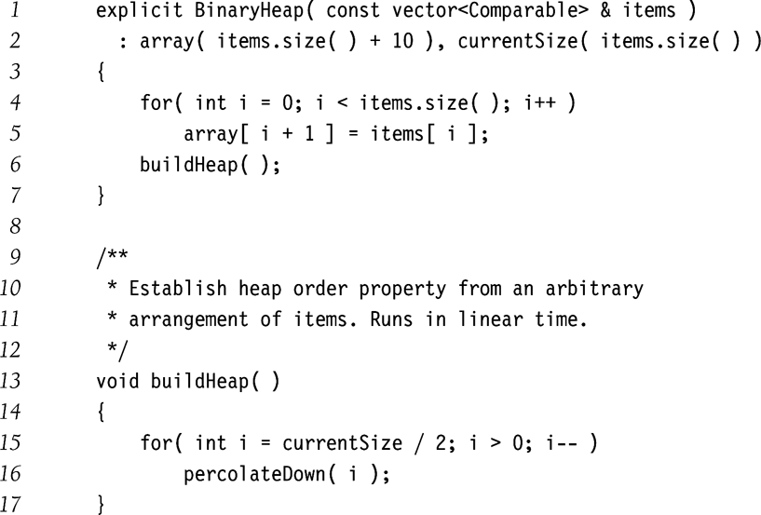
Constructor

Slide 21
Example
percolateDown(7)
percolateDown(6)
percolateDown(5)

Slide 22
percolateDown(4)
percolateDown(3)
percolateDown(2)
percolateDown(1)

Slide 23
C++ STL Priority Queues
priority_queue class template
Implements deleteMax instead of deleteMin in default
MaxHeap instead of MinHeap
Template
Item type
container type (default vector)
comparator (default less)
Associative queue operations
Void push(t)
void pop()
T& top()
void clear()
bool empty()

Slide 24
#include <iostream>
#include <vector>
#include <queue>
#include <functional>
#include <string>
using namespace std;
// Empty the priority queue and print its contents.
template <typename PriorityQueue>
void dumpContents( const string & msg, PriorityQueue & pq )
{
cout << msg << ":" << endl;
while( !pq.empty( ) )
{
cout << pq.top( ) << endl;
pq.pop( );
}
}
// Do some inserts and removes (done in dumpContents).
int main( )
{
priority_queue<int> maxPQ;
priority_queue<int,vector<int>,greater<int>> minPQ;
minPQ.push( 4 ); minPQ.push( 3 ); minPQ.push( 5 );
maxPQ.push( 4 ); maxPQ.push( 3 ); maxPQ.push( 5 );
dumpContents( "minPQ", minPQ );
dumpContents( "maxPQ", maxPQ );
return 0;
}

Slide 25
Reading Assignment
Chapter 7

