Slide 1
On Repairing Timestamps for Regular Interval Time Series
Presenters Saransh Bogati Ronast Subedi
Authors: Chenguang Fang, Shaoxu Song, Yinan Mei Proceedings of the VLDB Endowment Volume 15, Issue 9

Slide 2
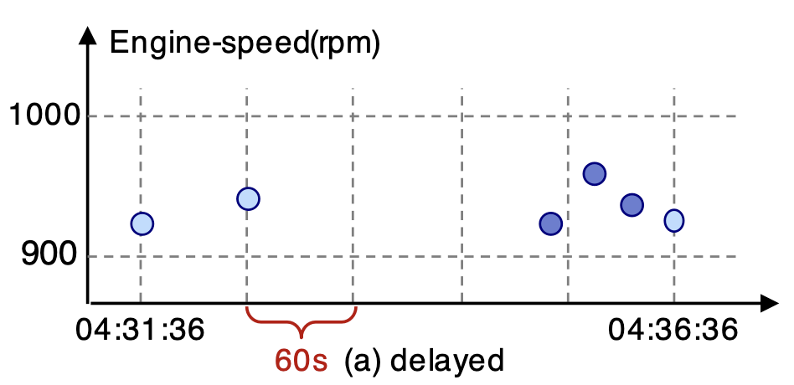
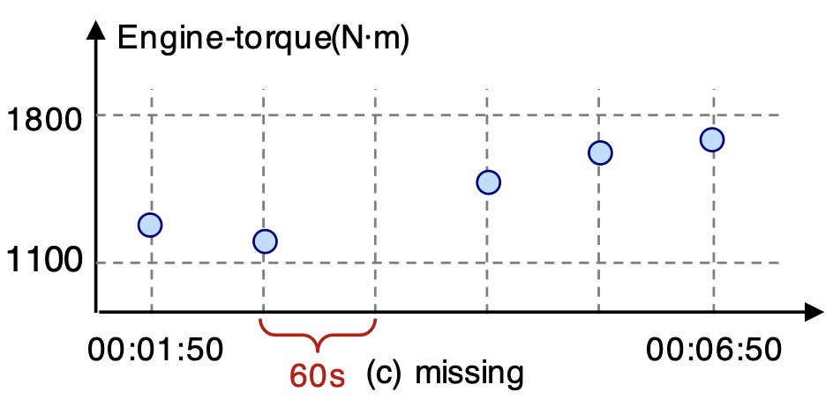
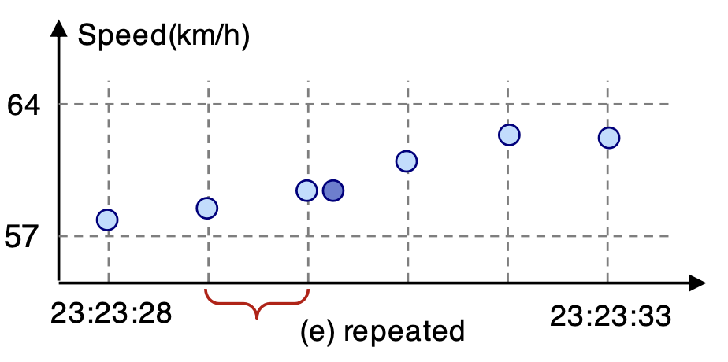
Introduction
Time series data are recorded on specific time intervals
However, various issues can make timestamp irregular
Due to transmission latency
Due to device failure
Due to multiple requests

Slide 3
Motivation
Fixing irregular timestamps helps to:
Improve data quality
Better data analysis in Frequency Domains and Machine Learning applications
Effectively compress the data for storage

Slide 4
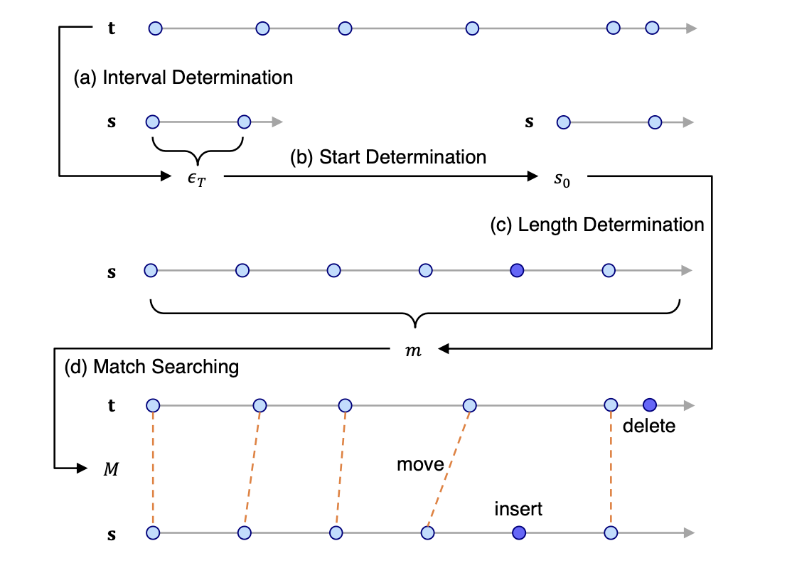
Challenges
Repairing irregular timestamp requires determining interreacting factors such as
the time interval
the start timestamp
the length of time series
matching between the time series before and after repairing
t = Original time series(can be irregular)
s = Regular interval time series

Slide 5
Previous Works
CTTC (Song et al.): Proposes timestamp correction using temporal constraints by selecting candidate corrections, though it struggles with missing or repeated data points
Heuristic Approach (Bohannon et al.): Utilizes class equivalence and a greedy algorithm for timestamp repair but cannot directly modify data due to integrity vs. temporal constraint separation
SCREEN (Song et al.): Repairs stream data under speed constraints by considering the entire sequence and handling out-of-order arrivals assuming that speed constraints are known and reliable
Holistic Approach (Chu et al.): Applies denial constraints for global timestamp repair using a unified objective but does not handle missing or duplicated entries

Slide 6
On Repairing Timestamps for Regular Interval Time Series
Given:
Time series t with timestamps {𝑡₀,𝑡₁,...,𝑡_{𝑛−1} } (which can be irregular)
Regular interval time series s, {𝑠₀,𝑠₁,...,𝑠_{𝑚−1}}
Goal: Repair the original time series t into a regular interval time series s
Objective: Minimize the repair cost
Allowed operations: move, insert, delete
To determine: optimal interval, start point, and series length of s

Slide 7
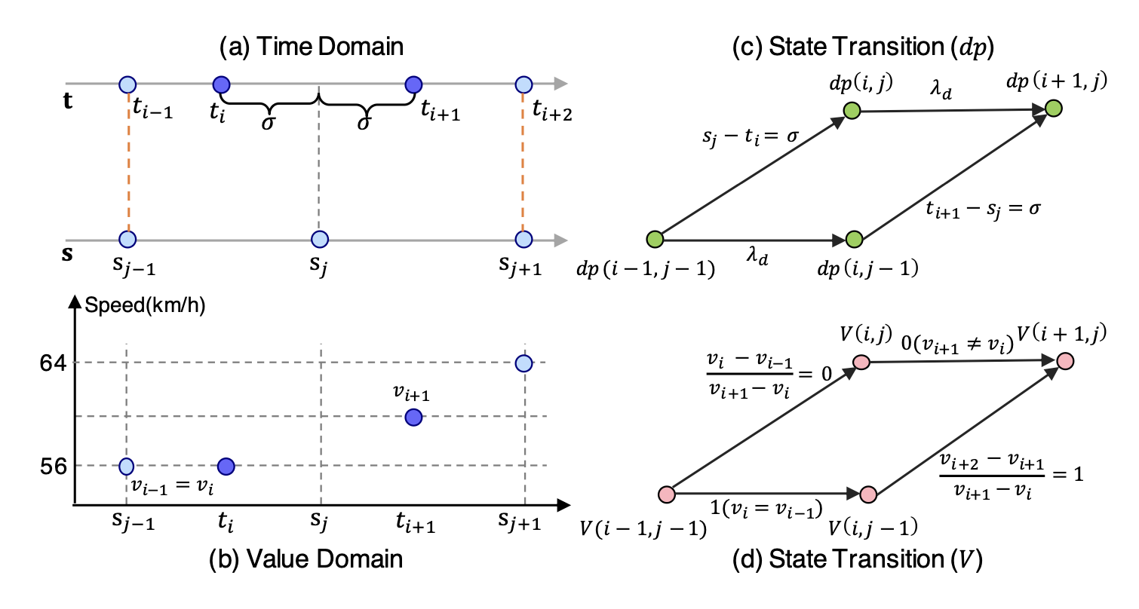
Methodology (Match Search Algorithm)
Given t and s, match search finds the match 𝑀 that minimizes the repair cost which comprises the cost for move, delete, and insert operations

Slide 8
Methodology (Traceback Algorithm)
After completing the match search, traceback algorithm traces back the optimal alignment path
Identifies which operations (insert/delete/move) needs to be chosen to reach the best cost
Determines the best starting point and regular interval for the repaired sequence
Essentially reconstructs the exact steps to transform the dirty data into clean form

Slide 9
Methodology (RIR-Exact: Exact Regular Interval Repair)
Uses the results from traceback to perform a full, optimal repair on the timestamps
Applies the move, insert, or delete operations exactly where needed for a perfect regular interval
Guarantees minimum repair cost but may be computationally expensive
Best used when accuracy is more important than speed

Slide 10
Methodology (RIR-Appr (Approximate Regular Interval Repair))
A faster version of RIR-Exact, designed to handle noisy data
Divides the sequence at median into two subsequences and minimizes the repair cost based on bi-directional dynamic programming
Uses the median to estimate the best start time and interval
Useful when speed is more critical than accuracy

Slide 11
Experiments and Results
Experiments on
3 real-world datasets: Engine, Turbine, Vehicle
3 synthetic datasets: Energy, PM, Air Quality
Baseline Methods
SCREEN, CTTC
Comparison Metrics:
Root Mean Squared Error (RMSE): Measures average magnitude of errors between predicted values and actual observed values in a dataset
Time Cost: Time to run the algorithms

Slide 12
Experiments and Results

Slide 13
Experiments and Results

Slide 14
Conclusion
Developed a unified framework to repair irregular timestamps using insert, delete, and move operations
Proposed dynamic programming-based RIR-Exact algorithm to efficiently recover optimal interval, start time, and sequence length
Developed a bi-directional dynamic programming-based approximation for slightly less precise but more efficient timestamp repair
Achieved superior performance consistently on RMSE and Accuracy the metrics by outperforming existing repair algorithms like SCREEN and CTTC
Future Work: Incorporate data features while determining the repair cost

