Slide 1
RapidMatch: A Holistic Approach to Subgraph Query Processing
Authors: Shixuan Sun, Xibo Sun, Yulin Che, Qiong Luo, Bingsheng He
Presented By: Anuj Rao(AC23CE), Venkatappa Reddy (VS23I), Amulya (LR23BA)

Slide 2
Problem & Motivation
Subgraph Query processing plays crucial role in graph analytics with applications like Fraud Detection and Bioinformatics.
Most Existing methods are either exploration based or join based.
Exploration based and Join based systems have complementary strengths.
Existing techniques specialize either in small queries or large queries, but not both.
A unified solution that’s fast, scalable, and effective for any query size.

Slide 3
Existing Methods
Exploration Based Algorithms:
CLF-Match, DP-iso
Good at handling large query graphs.
Poor enumeration efficiency for small queries
Join Based Algorithms:
EmptyHeaded, Graphflow
Optimal for smaller query graphs.
Struggles with large query graphs due to exponential join plan space.

Slide 4
Key Innovation
A join based engine with Graph exploration capabilities.
Small Queries:
Uses WCOJ (Worst-Case Optimal Join) for low-cost, scalable enumeration.
Applies intersection caching and trie encoding to minimize overhead.
Large Queries:
Applies graph-based pruning using semi-joins to eliminate false candidates early.
Uses nucleus decomposition to guide join plan through dense query regions.

Slide 5
Architecture Overview
Relation Filter: Prunes data with semi-joins.
Join Plan Generator: Uses nucleus forests to optimize execution order.
Relation Encoder: Organizes data into efficient formats.
Result Enumerator: Executes optimized joins with caching and pruning.

Slide 6
Selection -
L(u1) = L(v1) and L(u1’) = L(v1’)
Semi Join Operation
R(u₁, u₂) = R(u₁, u₂) ⋉ R(u₁, u₃) ⋉ R(u₁, u₄)

Slide 8
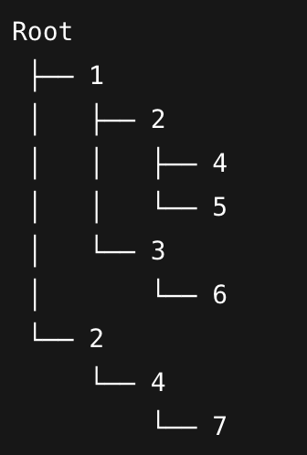

Slide 9
Failing set pruning - Avoid recomputing paths that already failed before.
Intersection on Caching - Reuse results of set intersections that are computed.
Set Intersection - Efficiently compute common neighbors using min property.

Slide 10
Performance Comparison
|E(Q)| - Number of edges in Query graph
|E(G)| - Number of edges in Data graph
|V(Q)| - Number of vertices in Query graph

Slide 11
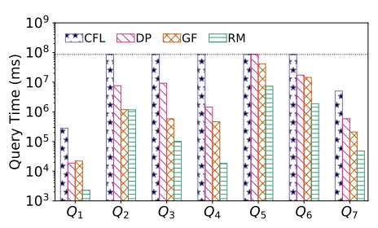
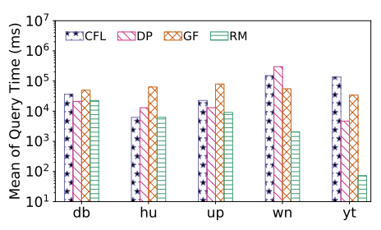
Performance Comparison
Query →
Dataset →
Performance of Small Queries
Performance of Large Queries

Slide 12
Results & Analysis
Key Findings:
Up to 3x speedup over prior methods on mixed workloads
Efficient for both small and large queries.
Scalable to millions of edges.
Why:
Filters early (prunes large amounts).
Avoids materializing large intermediate results.
Adjusts execution based on query size and density.

Slide 13
Conclusion
RapidMatch bridges the gap between exploration and join-based methods.
Efficient for all query sizes with graph-aware join plan generation
Future work may extend to:
Dynamic graphs
Edge-labeled or directed graphs

