Slide 1
Pison: Scalable Structural Index Construction for JSON Analytics
Fresh business general template
Applicable to enterprise introduction, summary report, sales marketing, chart data
Pramesh Regmi (pr23n)
Pratima Sapkota (ps23bc)
Desen Guo (gd19k)

Slide 2
INTRODUCTION
01
Paper, Author and JSON format
PROBLEM
02
AGENDA
Problem, Three observations and Approach
ALGORITHM
03
Structural indices construction
ENHANCEMENTS
04
Parallelization and Locality Optimization
EXPERIMENTS
05
Evaluation and Results

Slide 3
PAPER INTRODUCTION
Scalable Structural Index Construction for JSON Analytics
Author: Lin Jiang, Junqiao Qiu, Zhijia Zhao
Published: VLDB-2021
Domain: Optimized parsing of JSON datasets for faster overall query speed.

Slide 4
JSON FORMAT
JavaScript Object Notation – JSON is a data interchange format which is:
lightweight
text-based
language-independent
Core Structure: TEXT = OBJECT...OBJECT .
a document that is essentially a text representing one or more objects.
The object can be any of the following:
OBJECT = {STRING:VALUE, ..., STRING:VALUE}
ARRAY = [VALUE, ..., VALUE]
VALUE = OBJECT | ARRAY | STRING | NUMBER | true | false | null
JSON also uses backslash as an escape character: e.g. \" for a double quote, \\ for a backslash, \n for newline, \t for tab
Notes:
The backslash (or the escape character) is important because it adds to the complexity of the parsing.

Slide 5
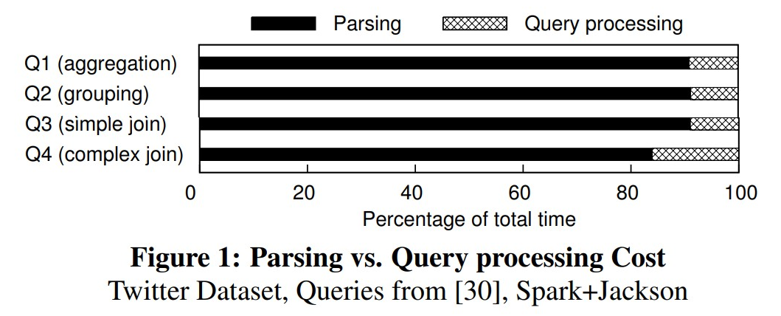
PROBLEM
JSON parsing dominates performance and cost.
JSON data must be parsed to be analyzed or further processed.
Parsing JSON data is expensive.
In complex queries involving joins and aggregations, cost of a query is dominated (> 80%) by parsing operation of the raw JSON data.

Slide 6
Opportunity in Problems
2. JSON data has no schema, but typically a limited number of different JSON structural variants in a JSON data stream or JSON collection.
Three observations
1. Applications typically only make use of certain fields.
3. Only a few kinds of characters can determine the exact position of a JSON field in a JSON record of a specific structure.
Notes:
1. Traditional JSON parsing generally reads and constructs the entire parse tree from the entire JSON document. This can be wasteful, since in many scenarios (e.g., event processing, analytics pipelines) you only need a subset of the fields out of a much larger JSON. Most real-world applications don’t need every single field from a JSON record. If we can detect which fields matter early, we can reduce parsing overhead by focusing only on data that’s relevant to the application.
2. Even though JSON is ‘schemaless,’ real-world data is usually quite structured. This means we can treat each structure as a known template and parse it faster—rather than dealing with truly arbitrary shapes every time.
3. In JSON, only certain characters actually matter for the structure: {, }, [, ], ,, :, and quotes for field names. Everything else (letters, digits, whitespace) is just payload content, not structural delimiters. Because only a handful of characters drive the structure, we don’t need to interpret every single character in the JSON. A specialized parser might jump from one structural character to the next, ignoring the bulk of the text if it’s not needed.

Slide 7
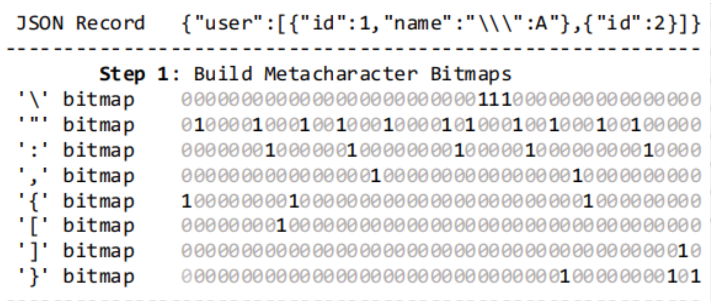
MOTIVATION
Traditional methods use automata by traversing character-by- character e.g. RapidJSON.
Mison - generates bitmaps (bitwise indices) for each character, avoids character-by-character mapping
Does it by loading the data into cache and generating the bitmap
Assumption - records fit into the caches
For smaller records locality is automatically achieved
For larger, more pragmatic data loads, it has limited scalability, less parallelization, poor data locality and costly memory operations
Notes:
Pushdown automata - traverses JSON in serial and identifies nested structures in a stack.
Bitwise indices help to skip irrelevant characters and jump to the relevant ones.
Mison - an algorithm for structural indices for JSON.
Mison assumes the records fit into the caches, so offers poor data locality for bulky records.
Scalability is limited in the present implementation. Index construction is mainly sequential, limiting the parallelization.

Slide 8
PISON
JSON Parser - built on top of Mison
Memory-efficient solution for bulky records
Offers better data locality by processing JSON in chunks
Exploits SIMD processor and utilizes parallelization
Notes:
Since mison has performance bottlenecks for large JSON, Pison solves it by the redesign of the index construction steps.
Introduces parallelization by exploiting the SIMD processors.

Slide 9
ALGORITHM
Notes:
1. Looks through the JSON metacharacters and build bitmaps. Assigns 1 wherever located.
2. Remove escaped quotes by scanning 3 consecutive \\\ as the quotes are escaped by \ which is further escaped by \ b.
3. Build a string mask bitmap by taking the prefix-sum of XOR to the quote bitmap. The resulting bit at index i equals the XOR of all bit values up to i (inclusive) (left to right)
4. Removes metacharacters inside the string by step 1 AND NOT step3
5. Generates levels using colons and commas.

Slide 10
QUERYING
Notes:
Then the query is answered using the leveled bitmaps and string mask. Evaluation starts at the top level, and scans between the 1s and continues.

Slide 11
PARALLELIZATION
Dependence in between the index construction steps
Dynamic Partitioning : Partitions JSON records into chunks such that no keywords or backslash sequences are cut.
Context Inference : Chunks are examined if they start inside or outside the string using hypotheses. On error, returns the opposite.
Speculation: If not clear, speculates it is outside and revalidates using prior chunks. If invalid, fixed by flipping the string mask bit.
Index Generation and Merging: Indices for each chunks are calculated. A level counter is maintained and increased/decreased on encountering brackets. On merge, level is adjusted using the offset provided by previous chunk.
Notes:
Records are dependent with each other,so they can not be directly parallelized. Eg, if records are partitioned, we need to know if the partition starts inside/outside the string.
If the partition encounters such characters, it is moved left to adjust the boundary.
Chunks may start inside or outside the string. Examined using hypotheses (inside or outside a string). First assumes, it is inside and recognizes tokens in the chunk. If encountered error, returns its opposite i.e. outside.
If neither provides a clear answer, the algorithm speculates it is “outside” and then validates using ground truth of prior chunks. If the speculation is wrong, flips bits to correct the string mask.
Chunks are processed assuming it starts at level 0 and maintains a level counter for each. As the chunk is processed word by word, encountering a left bracket (or {, [) increases the counter while a right bracket (or }, ]) decreases it.
While merging, the ending level from one chunk becomes the offset for the next chunk. For instance, if the first chunk ends at level 1, then the indices in the next chunk are adjusted upward so that what was “level 0” locally now becomes “level 1” globally.

Slide 12
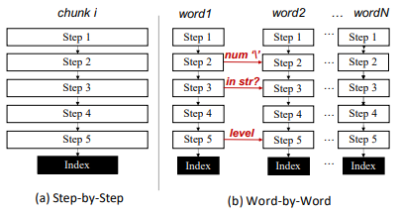
LOCALITY OPTIMIZATION
Step-by step index construction in entirety can exceed cache capacities for large records
If implemented word-by-word, bitmaps are generated and consumed incrementally with less memory overhead
Notes:
Steps share the bitmaps as one step writes to it and another step reads from it. Repetitive traverse of records for all steps can be problematic for bulky records.
So, constructed word by words known as chunks.
Words only occupy 8 bytes (for 64 bit machines), so repetitive access can be done efficiently by utilizing locality as they are less likely to exceed in the cache block.
For this we need to add some context between the words to encounter the dependence, but is still efficient.

Slide 13
EVALUATION
DATASETS USED
Best Buy (BB)
Twitter tweets (TT) Google Maps Directions (GMD)
National Statistics Postcode Lookup (NSPL)
Walmart (WM)
Wikipedia (WP)
PERFORMANCE RESULTS
(in terms of index construction)
19X faster than RapidJSON
11.6X faster than Pikkr
9.8X faster than CMison
8.8X faster than Mison+

Slide 14
RESULTS
Index Construction Time of Different Methods on Small JSON

Slide 15
RESULTS
Index Construction Time of Different Methods on Bulky JSON Records

Slide 16
RESULTS
Scalability over number of threads
Scalability over Record Size
Notes:
Compared over 1 to 8 threads
Compared over bulky record sizes

Slide 17
THANK YOU
Fresh business general template
Applicable to enterprise introduction, summary report, sales marketing, chart data
汇报人：优品PPT

