Slide 1
JOSIE: Overlap Set Similarity Search for Finding Joinable Tables in Data Lakes Team Members Lalith Sai Vejendla Sai Jayanth Immadisetty Madhura Mannava
.

Slide 2
INTRODUCTION
Modern data lakes aggregate massive, heterogeneous tables (e.g., enrollment records, transaction logs), creating opportunities for cross-table insights through joins.
Key challenge: Efficiently identifying joinable tables with significant column overlaps (e.g., Student ID for merging academic data, Transaction ID for fraud detection).
Traditional set similarity approaches (e.g., keyword/entity search) face exponential runtime growth when applied to real-world data lakes
JOSIE an exact algorithm for top-𝑘 overlap set similarity search, optimized for real-world data lake characteristics.
Dynamically balances posting list pruning and candidate validation to optimize efficiency and addresses skewed token distributions and duplicated posting lists for scalable performance.
Benefits in enabling the precise merging of critical datasets and enhancing data analysis efficiency by reducing computational overhead while guaranteeing exact results.
Skewed token distributions and duplicated posting lists degrade performance, leading to excessive computational overhead.
Column sizes with millions of values overwhelm conventional indexing and pruning strategies

Slide 3
PROBLEM STATEMENT
Given a query table TQ​ and a specified column Q, identify the top-k tables TX​ in the data lake that share the largest number of distinct overlapping values (intersection size) with Q.
Traditional exact algorithms (e.g., MergeList, ProbeSet) fail to handle massive dictionaries and large column sizes incurring prohibitive I/O and memory costs.
Existing threshold-based methods require users to guess overlap thresholds (θ), limiting exploratory analysis and usability.
Inverted indexes become impractical due to massive dictionary sizes (e.g., 563M tokens in Open Data) and skewed token frequencies.
The main goal is to develop an exact, scalable algorithm that adapts to real-world data lake challenges, optimizes resource usage, and eliminates dependency on user-defined thresholds for robust and trustworthy insights.

Slide 4
Existing Models V/S JOSIE
MergeList: Reads all posting lists for the query, incurring massive I/O costs for large queries (e.g., 100K values).
JOSIE: Dynamically decides whether to read posting lists (to tighten pruning filters) or verify candidates (to update the top-k threshold), minimizing total cost.
ProbeSet: Verifies candidates in fixed order (e.g., token frequency), leading to suboptimal pruning.
JOSIE: Prioritizes candidates with the highest pruning potential using a cost-benefit analysis, reducing unnecessary reads by 30–50%.
Approximate Methods (LSH Ensemble): Sacrifice accuracy for speed (e.g., 10–40% missed results).
JOSIE: Matches or exceeds LSH speed for small k(e.g., k=10) while guaranteeing correctness.
By balancing efficiency, accuracy, and adaptability to real-world data characteristics, JOSIE unlocks reliable insights from massive data lakes where traditional methods fall short.

Slide 5
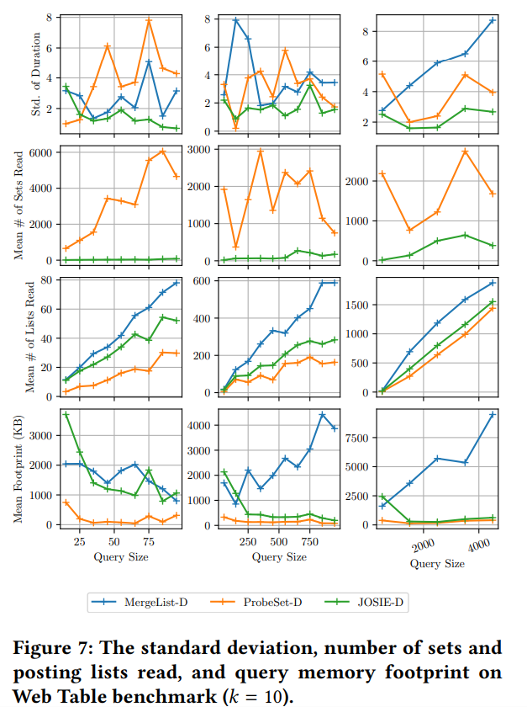
These above images describe how existing models perform when compared to JOSIE.

Slide 6
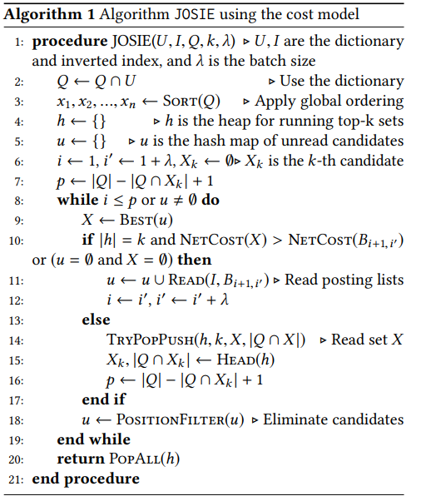
Working of JOSIE

Slide 7
Build the inverted index with posting lists, global token order (frequency-based), and duplicate grouping.
Filter out query tokens not in the index and sort tokens by frequency.
Read batches of tokens in frequency order (rarest first).
Compute upper-bound overlap using the position filter.
Prune candidates if their upper-bound overlap ≤ current threshold τ.
Choose between reading the next batch or verifying candidates based on a cost-benefit analysis.
For unpruned candidates, compute exact overlap and update the min-heap (top-k results).
Update τ to the k-th overlap in the heap.
Stop when processed tokens ≥ ∣Q∣−τ+1, ensuring no better candidates exist.

Slide 8
Datasets
OpenData: Tests scalability for large, skewed datasets (common in government/healthcare).
745,414 sets (columns) with 22M max values per column.
562M unique tokens (massive dictionary size).
WebTables: Validates efficiency for high-volume, small-column workloads (web data).
163M sets (columns) – 219x more than OpenData.
184M unique tokens (high token diversity).
Enterprise Data: Simulates real-world corporate scenarios with mixed data sizes.
2,032 sets with mixed sizes (small to large).
3.9M unique tokens (moderate dictionary size).

Slide 9
Python was used for its agility in data manipulation and analysis. Go was chosen for its speed, query engine, concurrency, and suitability in building scalable backend systems. Both together make JOSIE to balance developer productivity and runtime efficiency for large-scale data lakes.

Slide 10
Steps to DO
Initialize a PostgreSQL database and create optimized indexes for efficient query performance.
Compile and set up the JOSIE algorithm for execution.
Execute benchmark tests to compare JOSIE against baseline methods.
Measure query execution time, efficiency, and scalability of the algorithm.
Analyze performance trends and identify areas for optimization.

Slide 11
Thank You... Questions???
.

