Slide 1
Durable Top-k Queries on Temporal Data
Authors: Junyang Gao, Pankaj K. Agarwal, Jun Yang
Presenters: Sahiti Adepu (SA23BB)
Rakesh Duggempudi (RD23I)
Sharan Kumar Reddy Kodudula (SK24U)

Slide 2
WHY DURABLE TOP-K QUERIES?
Problem:
Snapshot queries miss historical trends.
Temporal data's historical context is often crucial.
Need for queries that consider data consistency over time.
Motivation:
Real-world Use: Many domains use temporal data.
Better Decisions: Analyzing trends improves decisions.
Challenges:
Computational Complexity
Variable k Handling

Slide 3
Formal Problem Statement
Durable top-k queries analyze temporal data to identify objects that consistently rank in the top k over a specified time interval.
Key Definitions:
Temporal Data:
Time domain T = {1,2,3...,m} represents discrete time points.
Objects {1,2,3,...,n} have time-varying values vi(t).
Ranking Function:
This calculates the rank of object i at time t based on its value relative to other objects.

Slide 4
Formal Problem Statement
Durability Formula:
Measures the fraction of time an object i remains in the top k during interval [a,b).
Query Result:
Returns objects with durability above threshold τ over interval I.

Slide 5
Existing Methods
Snapshot-based methods: For every time point, determine the top-k and tally which objects show up frequently enough. Very inefficient especially when the query interval is long.
TES (Top-k Event Summary) : Stores the changes in top-k membership. Processes intervals by moving through those change points. Time complexity is linear in how often objects enter or leave the top-k, which can be high for noisy or volatile data.
Prefix Sum Approach: Precomputes prefix sums of top-k membership for all objects. Fast for querying but still checks all objects. Poor scalability.
Interval Index: Indexes the time intervals where an object is in top-k. Can prune irrelevant objects but still inefficient when top-k membership changes frequently.

Slide 6
Durable Top-K with Fixed K
Baseline Methods: Used for comparision.
Prefix Sums
Interval Index
Reduction to 3D Halfspace Reporting - R-tree:
Transforms the durability query into a 3D geometric query by mapping object time-rank relationships into spatial regions, using R-trees to index and retrieve durable objects efficiently.
Uses four 3D R-trees for each interval type (0,0), (0,1), (-1,0), and (-1,1).
Avoids checking every object.
Highly accurate and highly efficient for selective, sparse queries.

Slide 7
Durable Top-K with Variable K
Sampling Based:
Samples a subset of time instants from the query interval and estimates durability based on sampled points, balancing speed and accuracy.
The key idea is to estimate durability by checking object ranks at a random subset of time points instead of the full interval.
Very fast and memory-efficient.
Accuracy is improved with more samples.
Ideal for long intervals and large datasets.
Index Based:
Data-Oblivious Indexing (DOS):
Indexes fixed k-values for all objects regardless of data, using nearest pre-indexed k to approximate durability.
Simple, fast and works without analyzing the dataset.
Space-efficient with tunable index size.

Slide 8
Durable Top-K with Variable K
Data-Driven Indexing: Selects k-values to index based on data and query workload to minimize expected query error.
Column-wise Indexing (COL):
Indexes the same subset of k-values (colums) for all objects and uses a shared substitute for unindexed k during querying.
More accurate than data-oblivious indexing.
Index size is tunable.
Simple and fast at query time.
Cell-wise Indexing (CEL):
Indexes a selective subset of object-k pairs (cells) and uses object-specific nearest substitutes to approximate durability with optimized accuracy and space use.
Highest accuracy among all approximate methods.
Efficient use of index space.

Slide 9
Two Phase Greedy Algorithm: Cell-wise Indexing (CEL)
Core method for scalable durable top-k queries with variable k
Evaluate all (object, k) pairs and estimate their contribution to accuracy
Rank pairs by how much they improve result quality (e.g., F1 score)
Select highest-impact pairs while respecting index size limits
Result: Compact index storing only essential entries for fast, accurate queries

Slide 10
Experimental Results
Datasets Used:
Real: Stock Ranking Dataset - Captures daily top-k stock rankings.
Synthetic: AR(1)-based simulated data - Emulates real-world ranking volatility (autoregressive).
Algorithms Implemented:
Fixed-k: PrefixSum, Interval Index, Geometric (R-Tree)
Variable-k: Sampling, DOS, COL, CEL
SAMPLE OUTPUT: Parameters: Top-k (k = 3), Durability (τ = 0.6)

Slide 11
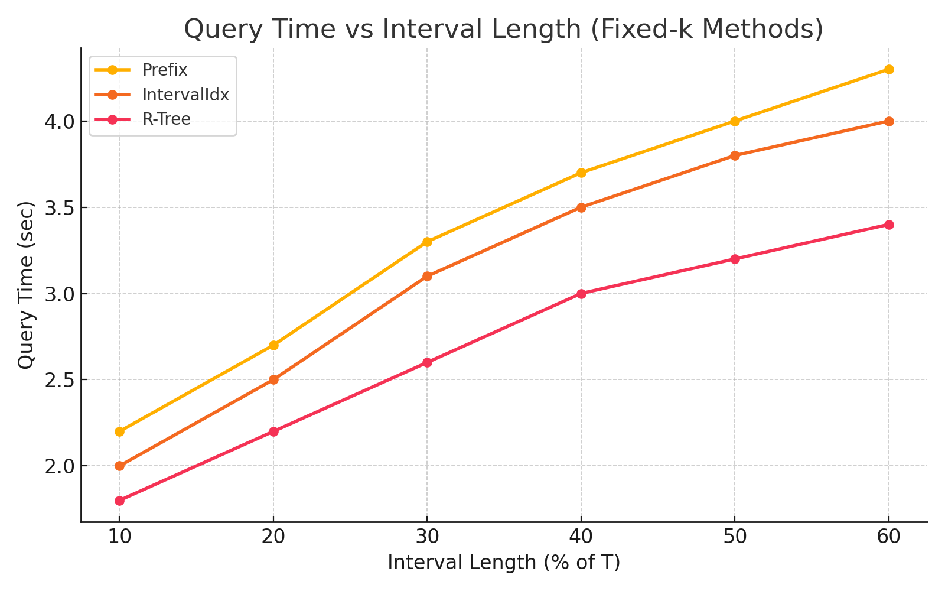
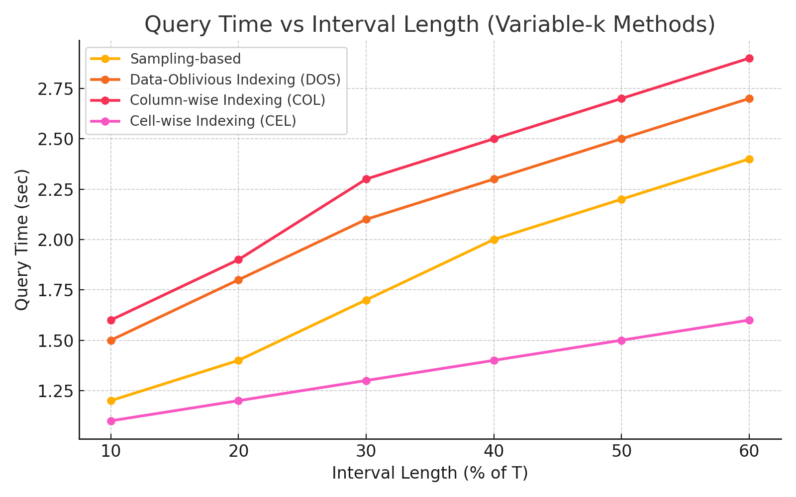
Performance Evaluation
Key Insights: CEL is the most efficient, consistently fastest (1.1–1.6s)
Note: This analysis is based on experimental evaluation using a dataset generated with the AR(1) model – an autoregressive time-series generator.

Slide 12
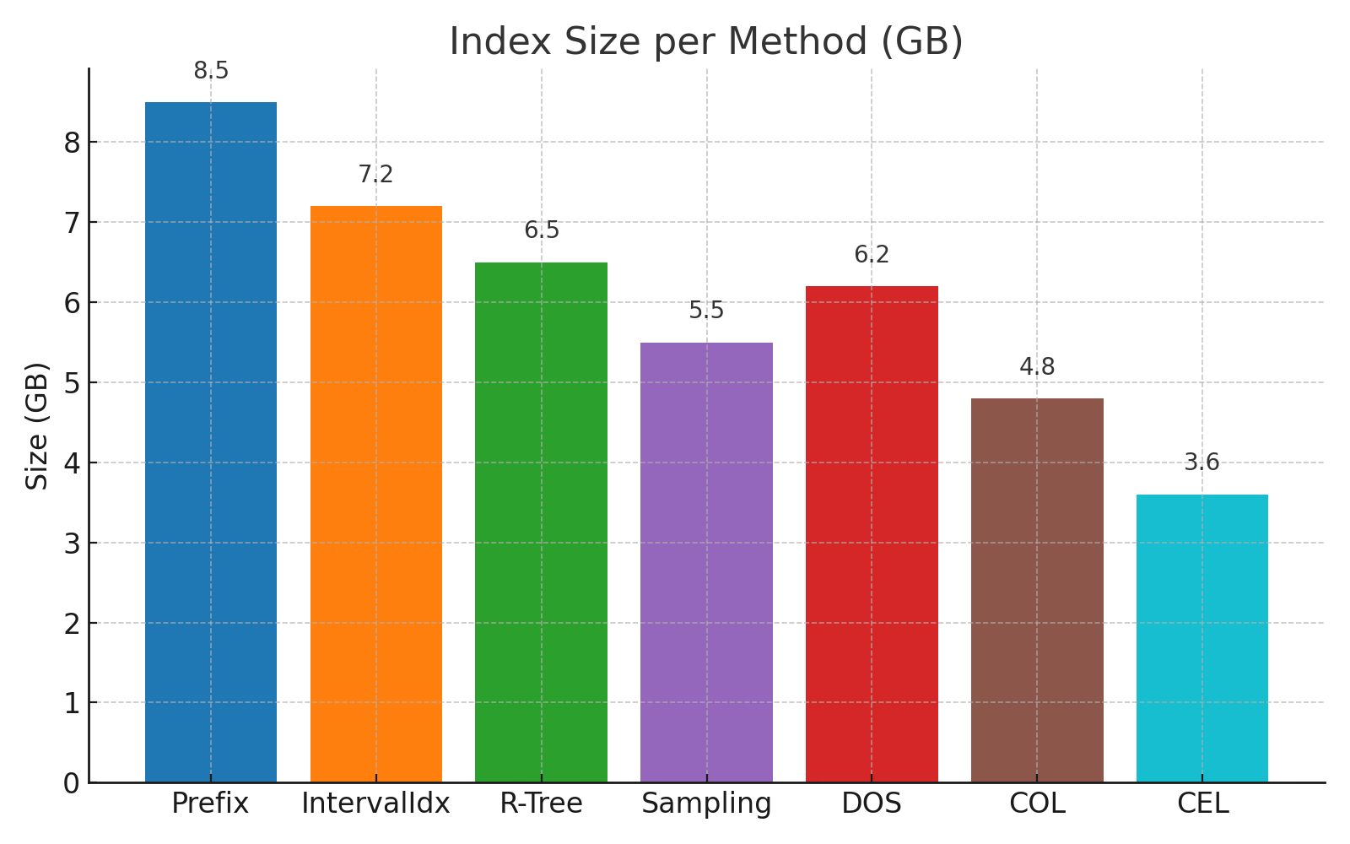
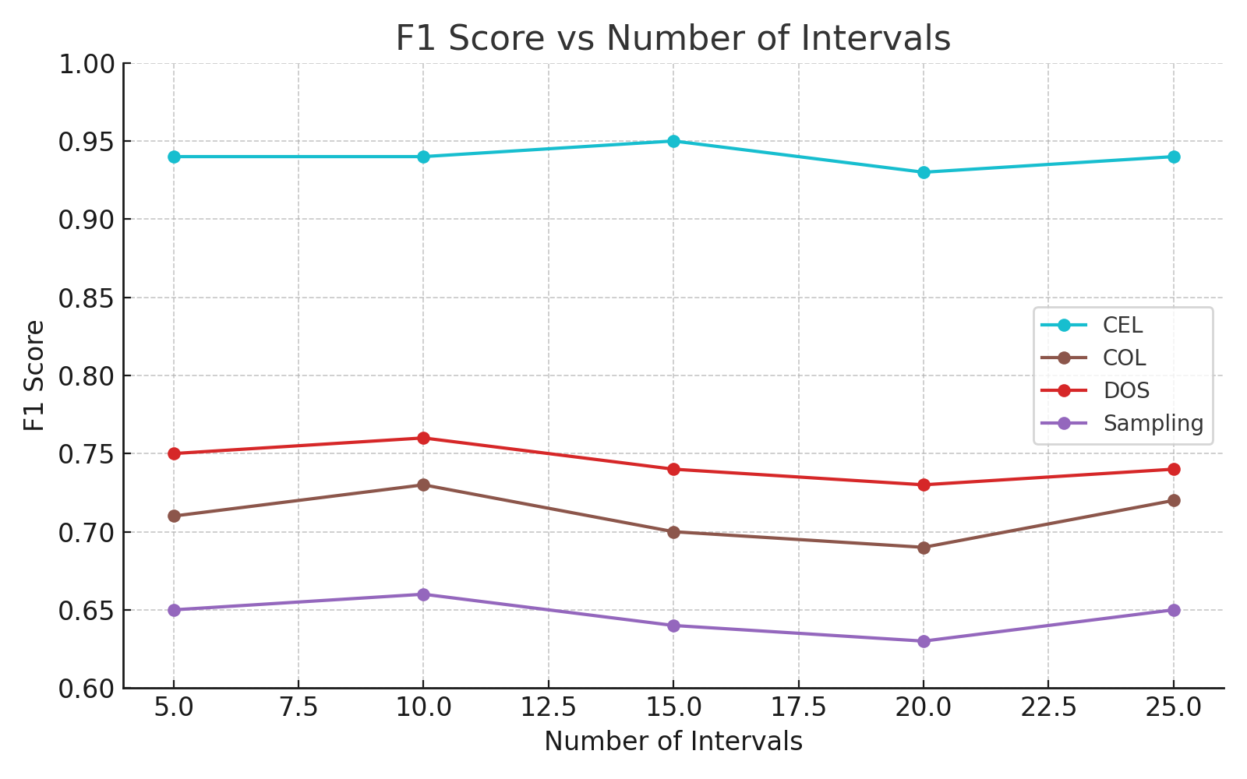
Performance Evaluation
Key Insights: CEL uses the least memory (~3.6 GB) and maintains the highest F1 score (~94%) across all interval counts.

Slide 13
CONCLUSION
Cell wise Indexing(CEL) consistently outperforms other methods (PrefixSum, Interval Index, R-Tree, Sampling, DOS, COL) in both speed and accuracy.
Demonstrates strong scalability on both real and synthetic datasets, maintaining low query time as interval length and data size increase.
CEL achieves remarkable memory efficiency, using as little as 3.6 GB while retaining exact-level accuracy.
CEL is ideal for real-time applications and large-scale systems due to its fast performance, compact index structure, and ease of integration.
Real-world Applications: Identify consistently top-performing stocks, treatments, sensors, and viral content over time.
Future Work:
Extend CEL for real-time streaming support with dynamic indexing.
Explore hybrid models that combine exact and approximate querying for adaptive accuracy.

Slide 14
Thank you!

