Slide 1
Sketching Linear Classifiers over Data Streams
Presented by:
Bhavya H S
Kiran B R
Kedarnath

Slide 2
INTRODUCTION
What is this paper about?
In today’s data-driven world, we are constantly faced with massive streams of data emails, logs, transactions, social media posts, and more. This project explores how we can train and maintain a machine learning model (specifically, a linear classifier) over these data streams using very little memory, all while still being able to:
Make accurate predictions in real time
Explain which features (like words) influence decisions
Adapt to evolving data patterns

Slide 3
PROBLEM STATEMENT
The increase in real - time streaming data has created new challenges:
Spam detection in emails and social media
Real-time fraud and anomaly detection in finance and IOT
Monitoring of network traffic and user behavior.
These applications run on edge devices with limited memory
Traditional classifiers like logistic regression are memory-intensive, especially in high-dimensional feature spaces
Need for lightweight models that balance efficiency and interpretability

Slide 4
Traditional methods
Traditional classifiers need to store full - weight vectors, which is infeasible on resource-constrained devices.
1. Feature Hashing
Projects high-dimensional input features into a lower-dimensional space using a hash function.
can't recover original features because of hash collisions
2. Simple Truncation
Keep only the top-K largest weights and set the rest to zero
Not memory-efficient during training ( need the full model first)

Slide 5
Traditional methods
3. Probabilistic Truncation
Small weights might still be included based on a probability
Still requires access to full weights during training
4. Count-Min Sketch
Tracks how often each feature appears using hashed counters
Only track frequencies, not weights
5. Space-Saving
Keeps track of the most frequent items using a fixed-size heap
Only track frequencies, not weights
No support for gradient-based learning

Slide 6
Core Idea: WM Sketch
Instead of storing millions of features with their weights use weight median sketch.
Compress the model weights using a compact data structure.
Supports online learning using gradient update.
Allow to recover the most important features: Top K from memory.

Slide 7
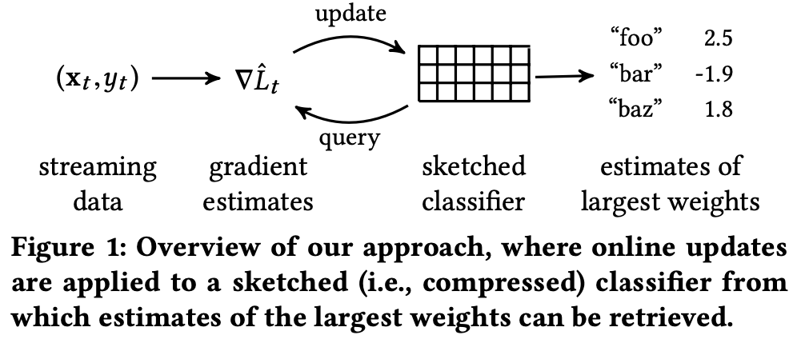
Methodology Overview
The WM-Sketch starts with a size-k array initialized to zero. This array is conceptually divided into s rows, each of width k/s.
The sketch compresses the high-dimensional weight vector w from d-dimensional space into a much smaller k-dimensional space through hashing
Two hash functions are used for each of the s rows. The first function maps the features from their original high-dimensional space to their respective buckets. The second function assigns a random sign (+1 or -1) to each feature

Slide 8
Methodology Overview
The gradient is calculated as the derivative of the loss function with respect to the model weights. This tells us how to tweak the weights to increase or decrease the loss.
the weights are updated by subtracting a fraction (defined by the learning rate) of the gradient.
Regularization is performed to to prevent overfitting by penalizing large weights.

Slide 9
AWM-Sketch Variant
The Active-Set Weight-Median Sketch (AWM-Sketch) is an enhancement of the basic Weight-Median Sketch (WM-Sketch)
This variant introduces a dynamic component—a heap (or “active set”)—to manage and track the most significant weights
It separates the handling of the most impactful features from those less so, enabling more accurate predictions and efficient resource use.

Slide 10
Experimental Plan
The evaluation for the performance of the proposed Weight-Median Sketch (WM-Sketch) and its variant, the Active-Set Weight-Median Sketch (AWM-Sketch), across several benchmark datasets.
Datasets used:
Reuters RCV1
Malicious URL Identification
Algebra Dataset from KDD Cup 2010

Slide 11
Results

Slide 12
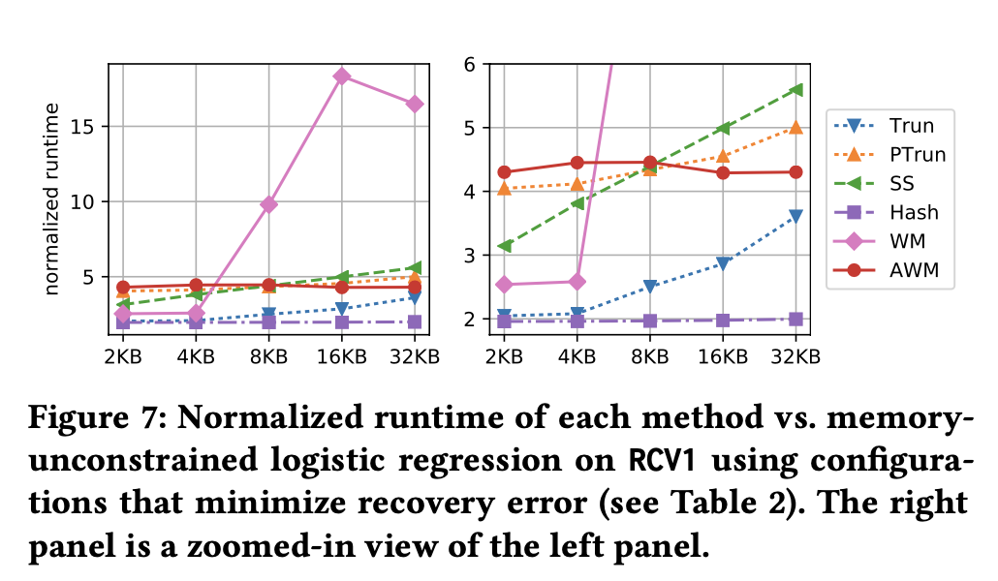
Results

Slide 13
Applications
1. Streaming Explanation
Goal: Identify features that explain why certain data points stand out in a stream
Example: Detecting outliers in sensor data (e.g., unusual time or location)
Approach:
Train a classifier to distinguish outliers vs. normal points
Use classifier weights or relative risk to identify key features
2. Network Monitoring
Goal: Identify significant differences in network traffic
Example: Detecting abnormal patterns between source and destination IPs
Approach:
Frame as binary classification between streams
Use learned weights to find high-ratio features

Slide 14
Applications
3. Streaming Pointwise Mutual Information (PMI)
Goal: Estimate correlation between co-occurring events (e.g., word pairs)
Example: NLP — finding strongly associated word pairs (“San” + “Francisco”)
Approach:
Turn PMI estimation into a classification task
Learn model weights that converge to PMI values
Use AWM-Sketch to store weights compactly

Slide 15
Discussion and Key Insights
1. Active Set vs. Multiple Hashing
Problem: High-weight features can collide in a bucket using multiple hashing.
Active Set Solution:
Add all features that hash to a heavy bucket into the active set.
In correctly added features decay over time → Automatically removed.
High-weight features are retained → Improves accuracy and disambiguation.
2. Cost of Interpretability
AWM-Sketch improves classification accuracy compared to feature hashing.
Why? Reduces collisions for heavily weighted features → Better model clarity.
Result: Higher accuracy without losing interpretability.

Slide 16
Discussion and Key Insights
3. Per-Feature Learning Rates
Adjusting learning rates for individual features may improve performance.
Challenge: Higher memory cost → Needs to be explored further.
4. Multiclass Classification
Maintain M copies of WM-Sketch (1 per class).
For large M → Computationally expensive.
Solution: Use noise contrastive estimation to reduce complexity.

Slide 17
Conclusion
Introduced Weighted-Median Sketch (WM-Sketch) for identifying high-weight features in streaming data.
Achieved better weight recovery and competitive accuracy compared to baselines.
Demonstrated strong performance on binary classification benchmarks.
Reframed stream processing tasks as classification problems.
Opens new opportunities in streaming analytics and machine learning.

Slide 18
THANK YOU

