Slide 1
BurstSketch: Finding Bursts in Data Streams
Project Presentation COP5725
Sean Fitzgerald
Ased Farooqi
Notes:
Sean here

Slide 2
What is BurstSketch?
Notes:
Sean here

Slide 3
Introduction
BurstSketch: data stream analysis algorithm designed to detect "bursts“
Burst: a sudden spike followed by a sudden drop in the frequency of items
Optimized for:
Real-time processing
High speed and volume
Efficient memory use
Notes:
Sean here

Slide 4
A quick Analogy
Notes:
Sean here

Slide 5
This helps systems respond and recover – not just react
Notes:
Sean here

Slide 6
Applications
Real time monitoring of high-speed data streams
Useful for anomaly detection, trend tracking
Examples: network traffic, social media, finance
Notes:
Ased
Moving onto the applications of the BurstSketch:
The BurstSketch is designed to monitor high-speed data streams in real time, which makes it ideal for spotting bursts.
It helps with quick anomaly detection in areas like network security or trending topic analysis in social media.

Slide 7
Motivation
Real-time detection is essential
Existing methods detect only increases
Count-Min Sketch (CM-PBE) and TopicSketch miss the decline
BurstSketch is the first to capture both the rise and the fall, in real time
Notes:
Ased here
Real-time detection is critical in high-speed data streams—if we miss a sudden spike or can’t react quickly enough, we lose valuable insights.
The difference with existing methods, such as CM-PBE and TopicSketch, is that they only catch the sudden increase but ignore the equally important decrease.
BurstSketch stands out by being the first approach to capture both the rise and the fall in real time, providing a more complete picture of burst events.

Slide 8
BurstSketch Overview
Two stages: Running Track and Snapshotting
Notes:
Ased here
Next, we will discuss the two stages of the BurstSketch process: Running Track and Snapshotting

Slide 9
Stage 1 – Running Track
Hashing & Bucketing map items using d hash functions:
h₁(e),h₂(e),…,h_{d}(e)
corresponding buckets stores (e,f)
Frequency Update Rule For item e:
if e is present, increment f (frequency)
else, decrement the current bucket’s count
If f ≥ H (item threshold), promote e to Stage 2
Efficiency
O(1) per item
filters out items that do not meet threshold H
Notes:
Ased here
In Stage 1, called the Running Track, each new item is hashed into d buckets. Each bucket stores the item ID and its frequency.
If the incoming item matches the ID in the bucket, we simply increment its frequency by 1; otherwise, we decrement the bucket’s frequency. This filters out less frequent items.
If an item’s frequency reaches the threshold H, it’s promoted to Stage 2 for more detailed monitoring.
Because each update is just a simple increment or decrement, we get a time complexity of O(1) per item

Slide 10
Stage 2 – Snapshotting
Dual Counters Each promoted item maintains
C_{pre}​ (previous window frequency)
C_{cur} ​(current window frequency)
along with a timestamp t.
Burst Detection Sudden increase if:
C_{cur} ≥ k $∙$C_{pre}
Sudden decrease if:
C_{cur} ≤$\frac{1}{k} ∙$C_{pre}
Accurate Reporting Items meeting both conditions are declared bursts,
ensuring no overestimation
Notes:
Ased here
Once an item is promoted to Stage 2, we track it using two counters: one for the previous window C_{pre} and one for the current window C_{cur}.
We also keep a timestamp t to mark when a sudden rise occurs.
Coming to burst detection, a sudden increase is detected if C_{cur} ≥ k × C_{pre} where k is constant parameter that dictates the size of the burst. Or if C_{cur} ≤ 1/k × C_{pre} a sudden decrease is detected.
This ensures we capture both the rise and the fall accurately, without overestimating.

Slide 11
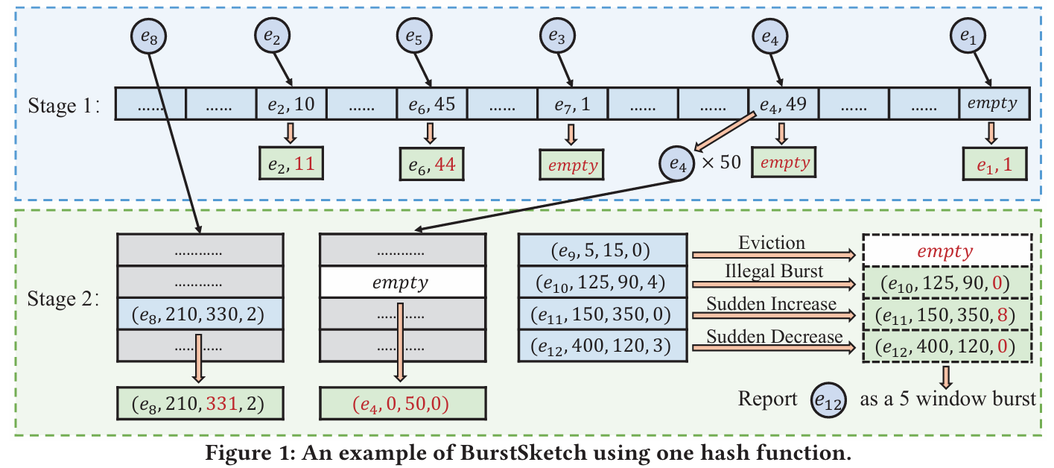
Example
$$350≥2⋅120$$
$$350≤\frac{1}{2}⋅150$$
$$120≥2⋅400$$
$$120≤\frac{1}{2}⋅400$$
C_{cur} ≥ k $∙$C_{pre}
C_{cur} ≤$\frac{1}{k} ∙$C_{pre}
INCREASE
Let:
d = 1
H = 50
T = 100
k = 2
DECREASE
Notes:
Sean here

Slide 12
Performance Evaluation
Notes:
Sean here

Slide 13
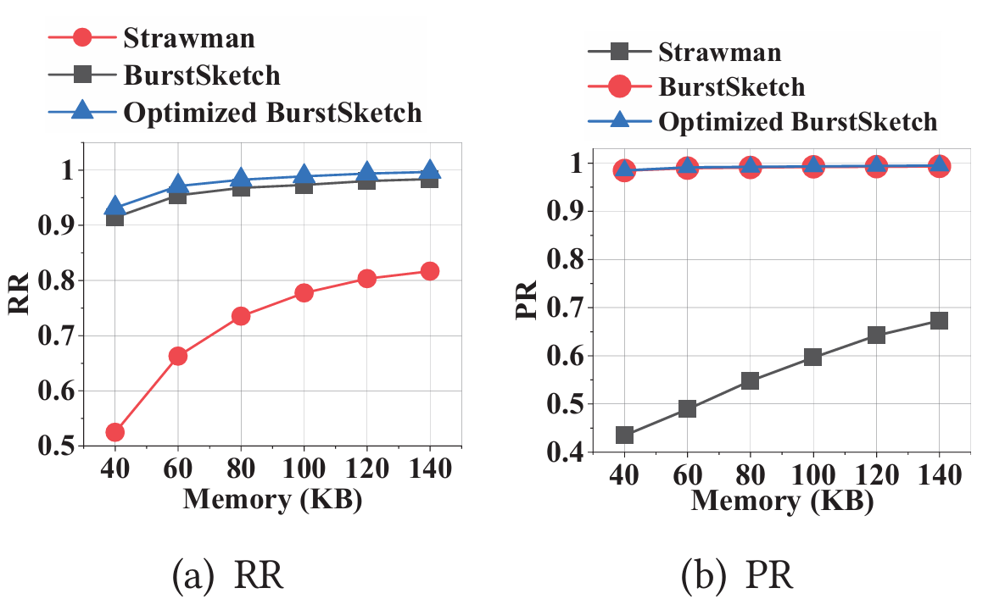
Strawman Approach:
Uses Count-Min Sketch
Serves as baseline
At 60 KB of memory BurstSketch:
Recall Rate (RR): ~42% higher
Notes:
Sean here

Slide 14
Strawman Approach:
Uses Count-Min Sketch
Serves as baseline
At 60 KB of memory BurstSketch:
Recall Rate (RR): ~42% higher
Precision Rate (PR): ~104% higher
Notes:
Ased here
As you can see, at 60 KB of memory, the precision rate is More than doubled that of the Strawman

Slide 15
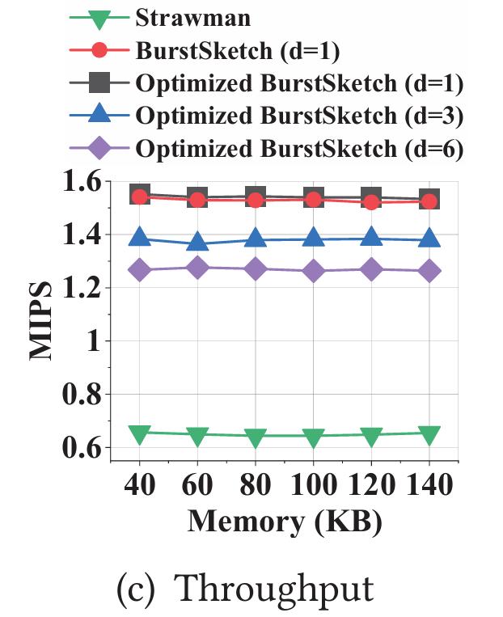
Strawman Approach:
Uses Count-Min Sketch
Serves as baseline
At 60 KB of memory BurstSketch:
Recall Rate (RR): ~42% higher
Precision Rate (PR): ~104% higher
Throughput: 143% higher
Notes:
Ased here
Here you can see that the throughput for the strawman is only 0.6 MIPS while the BurstSketch is much greater at 1.6 MIPS

Slide 16
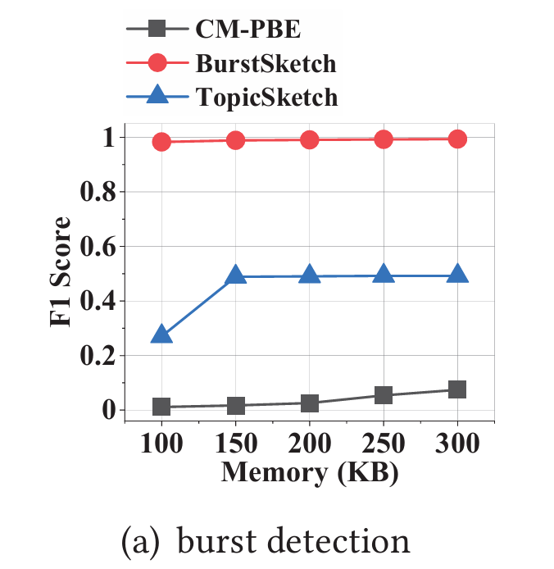
Comparing Existing Works
At 150 KB of memory:
F1 Score
BurstSketch: ~1.0
TopicSketch: ~0.5
CM-PBE: ~0.01
Notes:
Ased here
Finally, comparing the BurstSketch to the existing methods TopicSketch and CM-PBE, you can see that the BurstSketch has an F1 score of 1
The TopicSketch has around half of that at 0.5 and the CM-PBE is almost non-existent at 0.01

Slide 17
Conclusion
BurstSketch: fast, accurate, and memory-efficient
Better than traditional sketch methods
Ideal for high-speed, real-time data applications
Notes:
Sean here

Slide 18
Thank You
Notes:
Sean here

