Slide 1
NETS: Extremely Fast Outlier Detection from a Data Stream via Set-Based Processing
Authors: Susik Yoon, Jae-Gil Lee and Byung Suk Lee
Presenters:
Sakethram Naidu (SN24I)
Smriti Nair (SSN23B)
Roochita Ikkurthy (RI23B)
Notes:
The goal of the paper is to address inefficiencies in outlier detection in real-time data streams — and NETS proposes a faster, smarter way to do this using set-based updates

Slide 2
Problem & Motivation
Outlier detection in real-time data streams is crucial in domains like healthcare, finance, and security.
Most existing methods use sliding windows, where each window shift introduces expired and new data.
These methods treat expired and incoming points independently, failing to exploit spatial locality.
This results in high computational cost, redundant updates, and delayed detection of anomalies.
A more efficient method would process both slides together, minimizing recomputation.
Notes:
A popular model used in stream processing is the sliding window, where as time progresses, old data expires and new data arrives.
The problem with most existing methods is that they handle expired and new data separately, and do so point by point.
This completely ignores the fact that many points are spatially close to each other — meaning we’re doing a lot of redundant calculations.

Slide 3
Why Current Methods Struggle
State-of-the-art methods like MCOD and LEAP rely on point-based processing.
They handle each data point separately and process expired and new data independently.
This ignores proximity between points across slides, leading to unnecessary neighbor checks.
These repeated calculations lead to inefficiencies, especially in high-velocity data streams.
NETS introduces set-based updates and computes a net effect across slides to reduce overhead.
Notes:
Popular algorithms like MCOD and LEAP still rely on point-based processing.
Every single time the window moves, they recompute the neighbor relationships for each point, treating expired and new data separately.
This is inefficient — especially in fast data streams — and ignores how points often cluster together

Slide 4
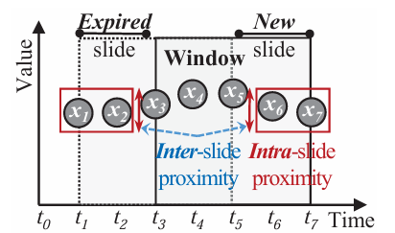
NETS - NET effect-based Stream outlier detection
NETS introduces set-based processing by grouping similar data points in grid cells.
Computes the “net effect” of expired vs. new data points in each region.
Avoids redundant computation caused by similar data in consecutive windows.
Leverages both intra-slide proximity and inter-slide proximity.
Leads to faster and smarter detection of true outliers
Notes:
Intra slide proximity – closeness of points within the same slide
Inter slide proximity – closeness of points in the expired and points in the new slide
Expired slide(t0-t2) is spatially close to the new slide =(t5-t7) and NETS helps us to cancel out by calculating the net and you don’t have to compute them separately and leads to faster outlier detection.

Slide 5
Grid Index & Cardinality Grid
The data space is partitioned into a grid of equal-sized cells (hypercubes).
Each cell represents a region of the space and acts as a set.
A cardinality grid maintains the number of points inside each cell.
Fast lookup: A point’s cell is computed via coordinate division.
Enables efficient net-effect calculation and set-level neighbor detection.

Slide 6
Cell-level and Point-level detection
Cell-Level Detection:
Compute neighbor lower (L) and upper (U) bounds.
If L(c) ≥ θK → all inliers.
If U(c) < θK → all outliers.
Point-Level Detection:
For non-determined cells, inspect individual points.
Use the prior window’s neighbour information.
Avoids full re-computation for most points.
L(c) = card(c) – 1 U(c) = Σ_{c’∈ N(c)} card(c’) + card(c) - 1
Notes:
Card(c) = number of data points in cell c
Card(c’) = sum of neighbors in surrounding cells
Theta k - a parameter used to define how many neighboring data points a point needs to not be considered an outlier

Slide 7
Experimental Results
Tested on 6 real-world and 1 synthetic dataset: Real-world datasets: STK, TAO, HPC, GAS, EM, FC. Synthetic dataset: GAU (Generated by a Gaussian Mixture Model with three distributions)
Algorithms Used: MCOD , LEAP , exact-Storm , Abstract-C and DUE
Comparison Metrics: CPU Time, Peak Memory Usage, Scalability, Robustness.
Parameters: θW, θS, θR, θK.

Slide 8
CPU Time:
NETS consistently exhibits the lowest CPU time across all datasets, indicating a high-speed improvement over other algorithms.
The time difference is especially noticeable in datasets like GAU and TAO, where NETS achieves a significantly lower CPU time.
Memory Usage:
NETS maintains consistently lower or comparable memory usage compared to other algorithms.
Despite having the fastest processing speed, NETS does not compromise on memory efficiency, making it suitable for real-time applications.

Slide 9
Metric | NETS (Proposed) | MCOD | LEAP | exact-Storm | Abstract-C | DUE
Speed Improvement | 10x | 1x | 0.42x | 0.0002x | 0.0002x | 0.0003x
Peak Memory Usage | Low | Moderate | High | Very High | High | High
Scalability | Excellent | Good | Poor | Very Poor | Poor | Poor
Robustness (Parameter Variations) | Excellent | Moderate | Poor | Poor | Poor | Poor
Efficiency with θW | Consistent | Inconsistent | Poor | Very Poor | Poor | Poor
Efficiency with θS | Minimal Impact | Significant Impact | Poor | Very Poor | Poor | Poor
Efficiency with θR | High Efficiency | Moderate | Poor | Very Poor | Poor | Poor
Efficiency with θK | Excellent | Poor | Very Poor | Very Poor | Poor | Poor

Slide 10
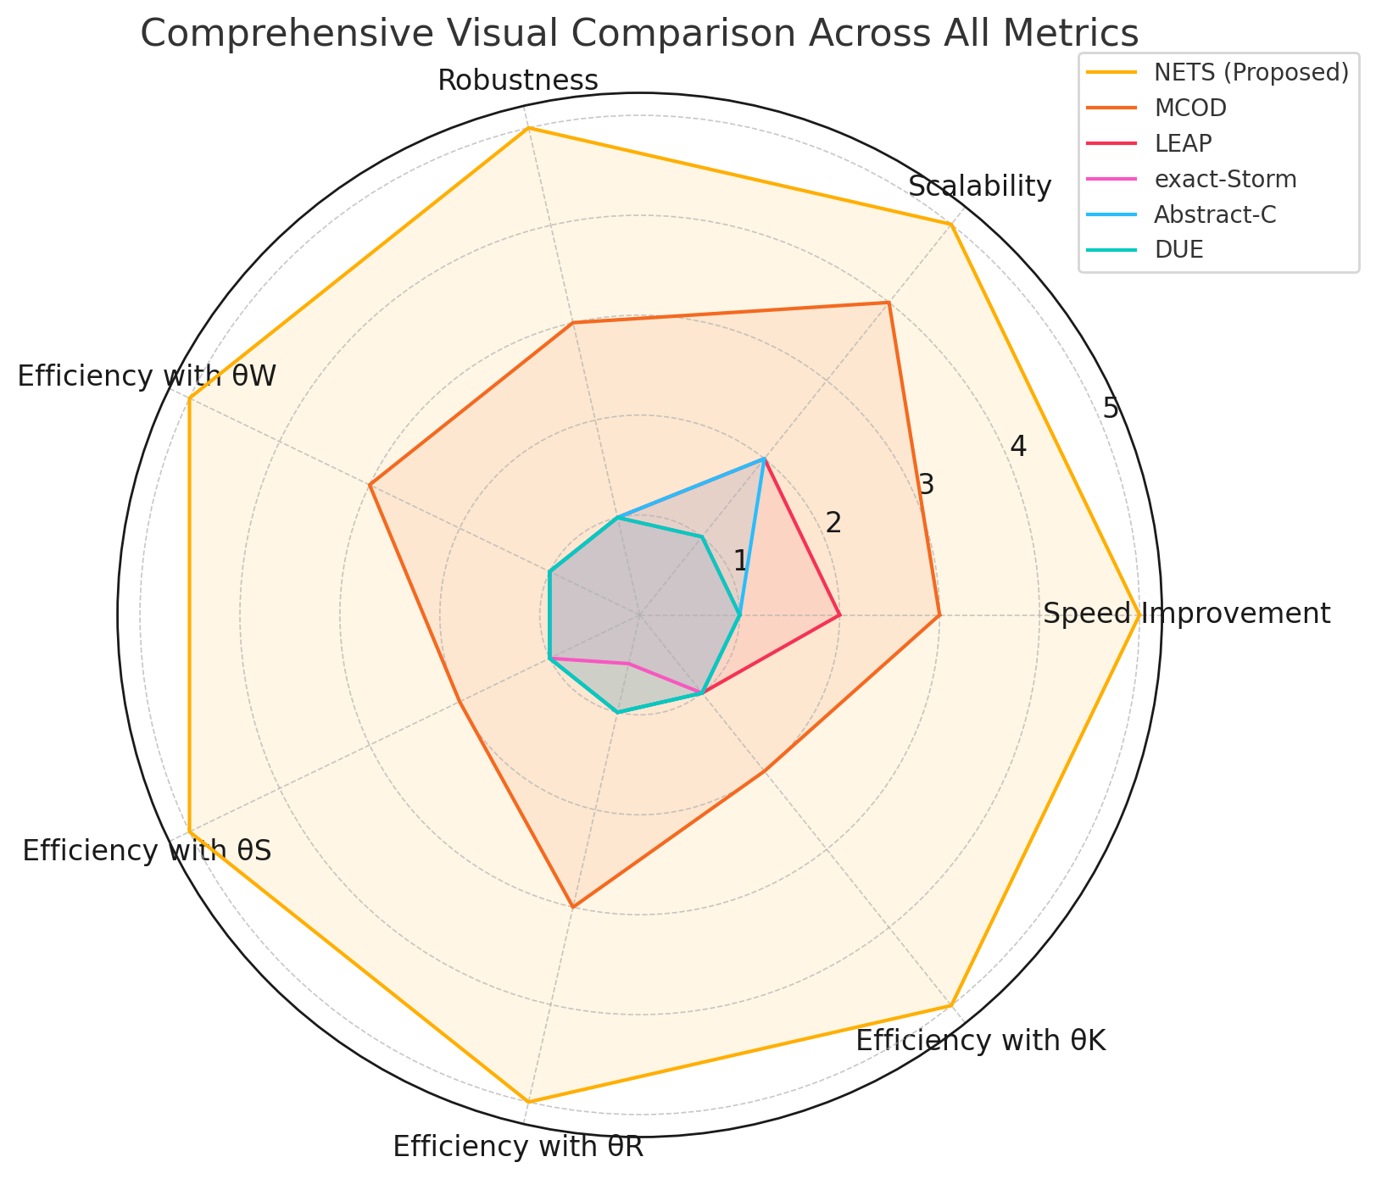

Slide 11
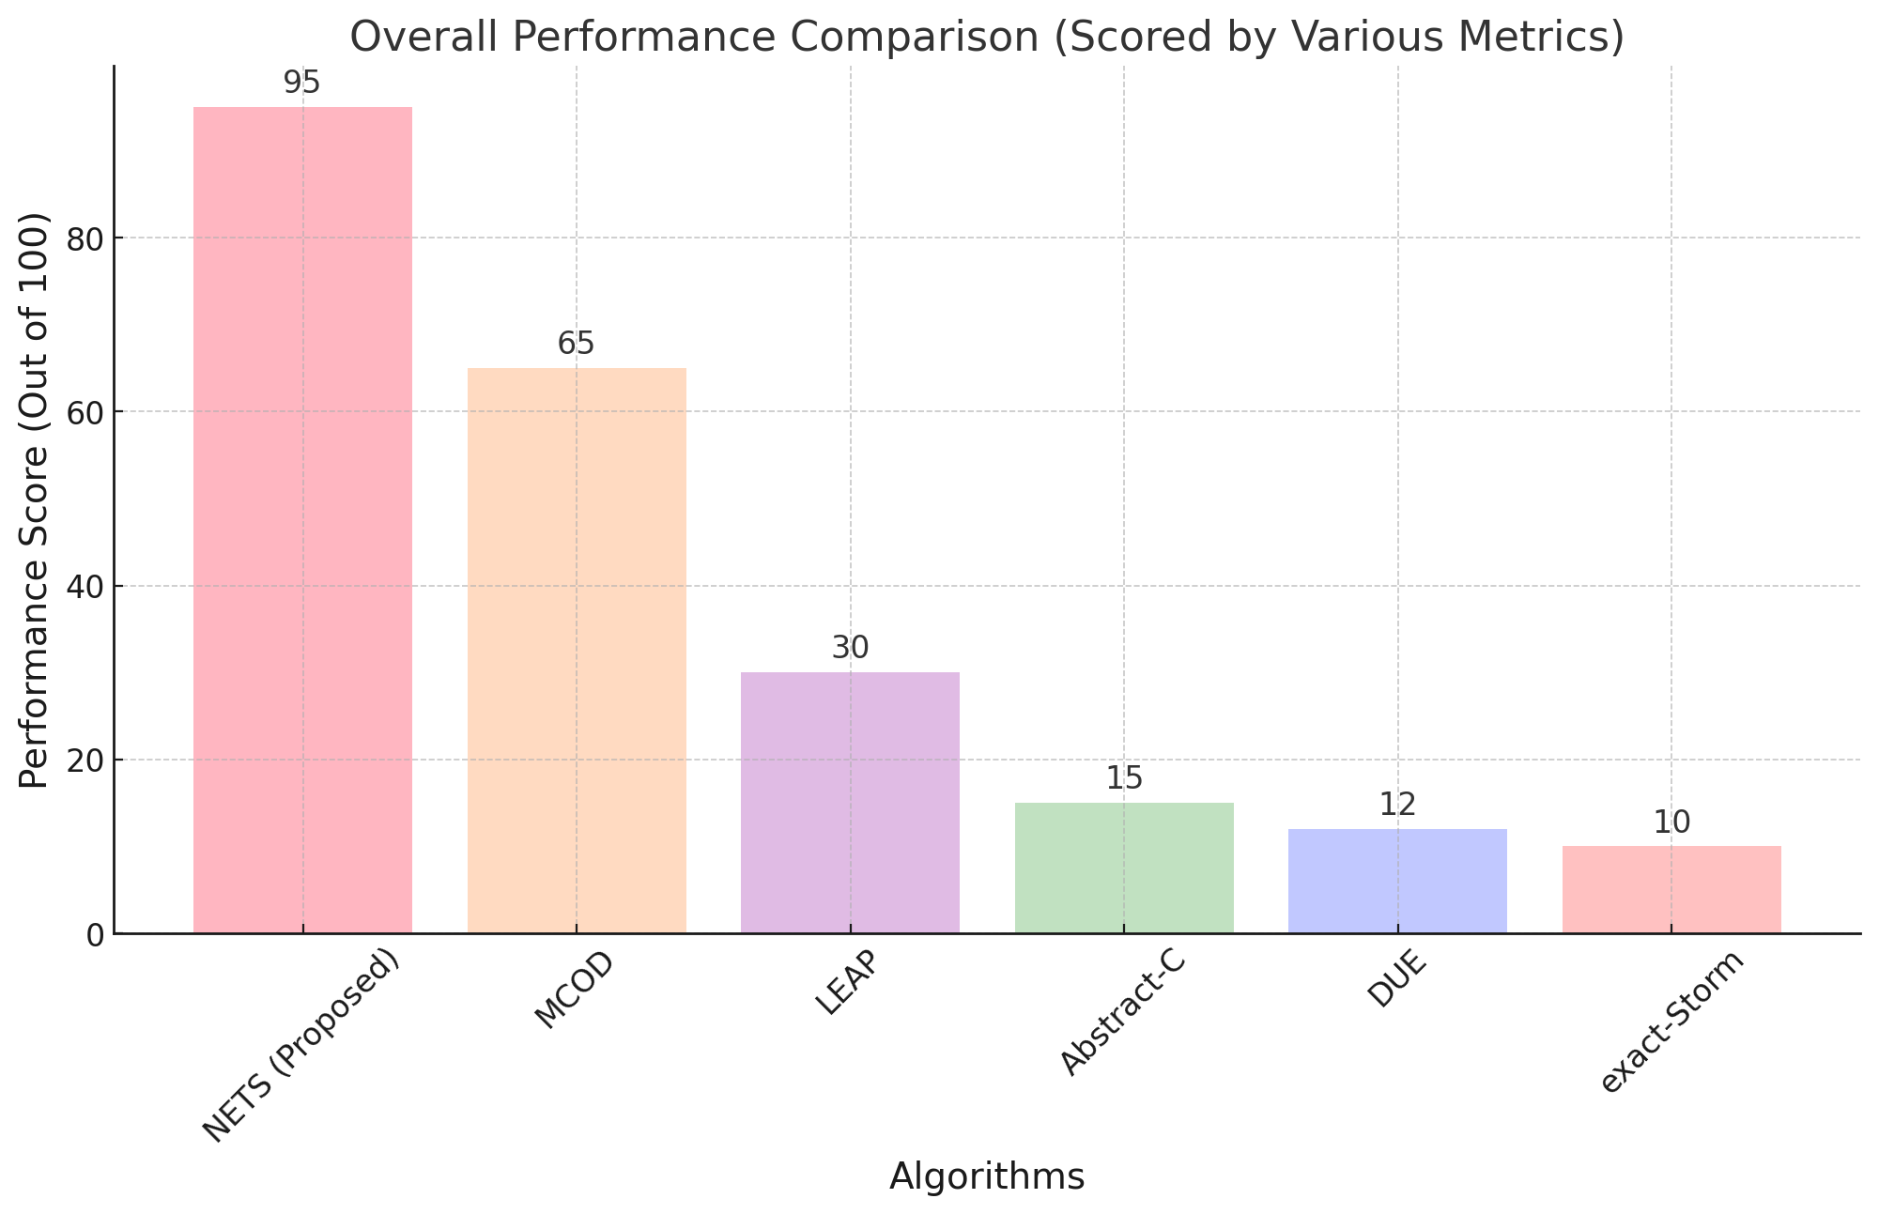

Slide 12
Conclusion
Superior Performance: NETS consistently outperforms existing algorithms (MCOD, LEAP, exact-Storm, Abstract-C, DUE) across all major performance metrics.
Scalability: Demonstrates excellent scalability across various datasets (GAU, STK, TAO, HPC, GAS, EM, FC), maintaining low processing time regardless of dataset size or complexity.
Memory Efficiency: Achieves remarkable efficiency in memory usage, performing better or comparable to other algorithms while processing data streams quickly.
Robustness: The algorithm remains robust under varying conditions of parameters (θW, θS, θR, θK), showing consistency across all scenarios.
Versatility and Practicality: NETS is particularly suited for real-time applications due to its low memory usage and high processing speed.

Slide 13
THANK YOU

