Slide 1
Word Embeddings-
A Discussion on Word2Vec & GloVe
By Deevesh Jain, Giulio Martini & ManiKishore Kamanaboina

Slide 2
Why word embeddings?
In today’s era of Generative AI, enabling machines to understand natural language has become essential.
Since machines interpret only numbers, converting words and sentences into vectors—while preserving their semantic meaning, relationships, and context—is crucial for NLP tasks.
Word2Vec and GloVe are two of the leading algorithms in creating these word embeddings.
Let’s explore how these algorithms address this challenge and the techniques that make them effective.

Slide 3
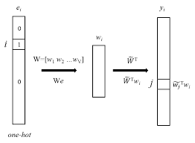
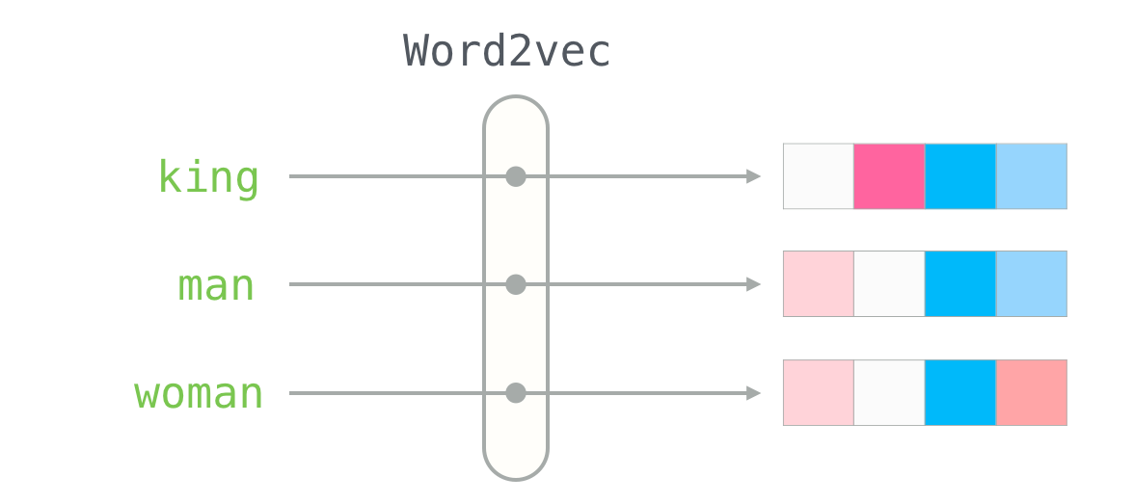
Let’s introduce our Word Embedding models
We’ve chosen 2 HISTORIC models:
Word2Vec
Glove

Slide 4
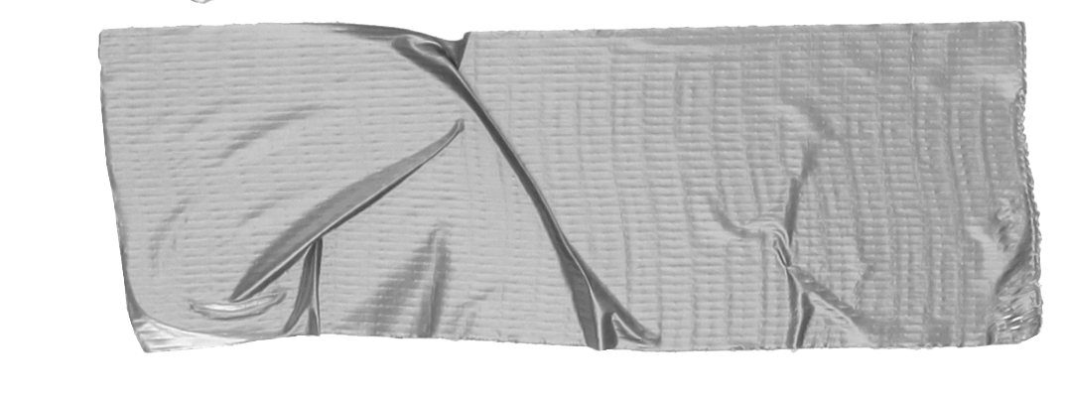
Word2Vec
Developed By: Tomas Mikolov and team at Google in 2013
Purpose word2vec creates dense vector representations of words to capture semantic similarities.
Key Idea Words that appear in similar contexts share similar meanings, allowing vector representations to capture relationships like "king" - "man" + "woman" ≈ "queen."
Applications Widely used in tasks such as semantic similarity, machine translation, and recommendation systems.

Slide 5
Glove
Developed By: Jeffrey Pennington, Richard Socher, and Christopher Manning at Stanford in 2014
Purpose GloVe generates dense vector representations by leveraging global word co-occurrence statistics to capture both semantic and syntactic relationships.
Key Idea Words that frequently co-occur with similar words have similar meanings. By analyzing global co-occurrence patterns, GloVe captures relationships, such as "Paris" - "France" + "Italy" ≈ "Rome."
Applications Widely used in natural language processing tasks such as sentiment analysis, named entity recognition, and knowledge-based applications.

Slide 6
VS

Slide 7
Word2Vec - Local Context Window
Uses local context windows, capturing relationships between words that frequently appear together in short sequences (e.g., within a sentence or a phrase).
Focus: Builds embeddings by learning from the immediate context surrounding each word.
Example: “Paris” and “France” often appear in similar sentence contexts, leading Word2Vec to capture their association.

Slide 8
Glove - Global Co-Occurence
Approach: Leverages global co-occurrence statistics, examining how often pairs of words co-occur across the entire corpus.
Focus: Captures broader relationships, enabling associations between words that may not appear close together but are related in meaning across the corpus.
Example: “Paris” and “France” may not co-occur in nearby contexts frequently, but their co-occurrence ratios with other words (e.g., “city,” “capital”) indicate a strong connection.

Slide 9
Word2Vec vs Glove - Unique methods for generating embeddings
Word2Vec:
Embeddings are generated by predicting word-context pairs, using CBOW (predicts the target word from its context) or Skip-gram (predicts context words from a target word).
Focuses on local relationships and local context prediction.
GloVe:
Embeddings are generated through matrix factorization on the global co-occurrence matrix, where each entry represents the frequency of word pairs across the corpus.
Focuses on global statistical relationships and co-occurrence ratios to identify meaningful word associations.

Slide 10
The Purpose of this comparison
Local vs. Global Context: Word2Vec captures relationships through nearby words (local context), while GloVe leverages global co-occurrence across the corpus for broader associations.
Impact on Meaning: Word2Vec’s local context is suited for tasks needing sentence-level context (e.g., recommendations), while GloVe’s global view benefits tasks needing broader semantics (e.g., knowledge-based tasks).
Strengths and Limitations: Word2Vec captures detailed, context-specific relationships; GloVe captures large-scale, semantic connections but may miss finer details.

Slide 11
The Purpose of this comparison
Local vs. Global Context: Word2Vec captures relationships through nearby words (local context), while GloVe leverages global co-occurrence across the corpus for broader associations.
Impact on Meaning: Word2Vec’s local context is suited for tasks needing sentence-level context (e.g., recommendations), while GloVe’s global view benefits tasks needing broader semantics (e.g., knowledge-based tasks).
Strengths and Limitations: Word2Vec captures detailed, context-specific relationships; GloVe captures large-scale, semantic connections but may miss finer details.

Slide 12
The Purpose of this comparison
Local vs. Global Context: Word2Vec captures relationships through nearby words (local context), while GloVe leverages global co-occurrence across the corpus for broader associations.
Impact on Meaning: Word2Vec’s local context is suited for tasks needing sentence-level context (e.g., recommendations), while GloVe’s global view benefits tasks needing broader semantics (e.g., knowledge-based tasks).
Strengths and Limitations: Word2Vec captures detailed, context-specific relationships; GloVe captures large-scale, semantic connections but may miss finer details.

Slide 13
Word2Vec - DeepDive
Word2Vec uses neural network-based techniques to create dense vector representations of words by learning relationships based on their context.
The model is trained to predict word context or target words, capturing semantic and syntactic relationships.
The embeddings represent words in a continuous vector space where semantically similar words are close to each other.

Slide 14
Word2Vec - Continuous Bag of Words (CBOW)
CBOW predicts the target word based on surrounding context words.
Example: In the sentence "king is the of," CBOW would use context words like “is,” “the,” “of” to predict the target word “king.”
The model takes a fixed-size window of context words and averages their vector representations to predict the target word.
The context vectors are passed through a hidden layer, and a prediction is made for the target word.
CBOW is faster than Skip-gram because it predicts only one target word for multiple context words, making it more suitable for large datasets.
CBOW processes training efficiently by using context to learn a word's representation in one pass.

Slide 16
Word2Vec - Skipgram
Skip-gram works oppositely: it takes a target word and predicts its surrounding context words.
Example: Given the word "king," Skip-gram would try to predict the words "is," "the," "of" from the target word "king."
For each target word, the model predicts multiple context words in a fixed-size window.
The model uses the target word to generate predictions for multiple words around it, learning how words are related to their context in more depth.
Skip-gram is more flexible than CBOW, especially for handling smaller datasets or words that appear infrequently, as it can capture rarer word relationships better.

Slide 17
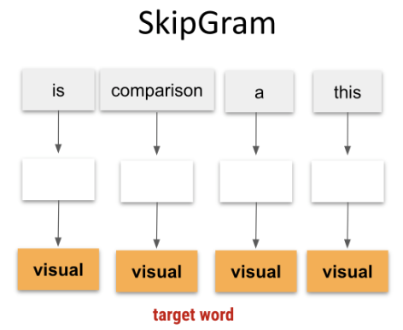

Slide 18
CBOW
vs
Skipgram

Slide 19
CBOW vs Skipgram
CBOW:
Faster training because it predicts one target word from multiple context words.
Works well for large corpora where speed is a priority.
Efficient for frequent words, but can miss subtler associations for rare words.
Skip-gram:
More flexibility and better at handling rare words and capturing complex word associations.
Takes more time for training, especially on larger datasets, because it predicts multiple context words for each target word.
Summary:
CBOW is ideal for large datasets with frequent words, focusing on speed and efficiency.
Skip-gram excels in learning word relationships in detail, especially when working with smaller datasets or rarer words.

Slide 20
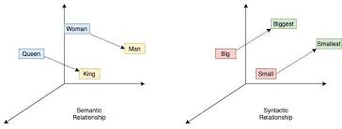
Glove’s approach
Glove
GloVe creates word embeddings by analyzing global co-occurrence statistics of words in a corpus.
It captures relationships not only based on immediate contexts (as in Word2Vec) but across the entire corpus.

Slide 21
Glove - Building the Co-Occurence Matrix
GloVe constructs a matrix where each entry reflects the frequency with which two words appear together.
For instance, words like "ice" and "solid" or "steam" and "gas" often co-occur, revealing meaningful relationships and shared contexts.
High co-occurrence between "solid" and "ice" but not "solid" and "gas" highlights semantic differences, which GloVe embeddings capture.
Corpus Wide-Context: This matrix captures not just sentence-level context but corpus-wide associations, enabling GloVe to understand words in relation to many others across the dataset.

Slide 22
Glove - Matrix Factorization and Benefits
GloVe uses matrix factorization to reduce the co-occurrence matrix into lower-dimensional word vectors.
This process maintains the statistical relationships found in the matrix, distilling complex, global co-occurrence patterns into efficient embeddings.
Semantic Similarity: Captures rich semantic information based on frequency patterns across the corpus.
Efficiency in Capturing Complex Relationships: GloVe’s global approach allows it to capture relationships that Word2Vec might miss with its local-only context window, making GloVe effective for tasks requiring broad semantic understanding.

Slide 23
Analogies and Vector Arithmetic in Word2Vec and GloVe
What is an Analogy?
An analogy represents relationships between words (e.g., “King - Man + Woman = Queen”).
Analogies test how well embeddings capture meaning and context through consistent word relationships.

Slide 24
How Word2Vec Handles Analogies
Word2Vec captures analogies by learning from local context and often represents syntactic and simpler semantic relationships.
Example: “Paris - France + Italy = Rome” emerges by capturing frequent local pairs in context windows.
Best for local, syntactic, and frequent relationships.

Slide 25
How Glove Handles Analogies
GloVe uses global co-occurrence patterns across the corpus, enabling it to capture broad associations.
Example: "Einstein - scientist + artist = Picasso" captures indirect associations based on large-scale co-occurrences.
Captures broader, corpus-wide patterns, making it effective for diverse semantic relationships.

Slide 26
Choosing
Between
The
2

Slide 27
When to use Word2Vec
Best for tasks requiring detailed, context-specific relationships.
Ideal for applications like question answering and recommendation systems, where understanding word relationships within sentences is essential.

Slide 28
When to use Glove
Suited for tasks that benefit from broader, global word relationships.
Effective for knowledge-based applications, general search, and translation, where corpus-wide associations enhance understanding.

Slide 29
Real Word Applications and Limitations
Real-World Examples
Analogy-solving helps improve information retrieval by identifying similar terms or concepts.
Supports models in understanding user intent and language generation, enhancing accuracy in diverse applications.
Limitations
Word2Vec: Needs large datasets to capture complex analogies effectively, due to its reliance on local context.
GloVe: Memory-intensive due to the co-occurrence matrix and may miss finer, context-sensitive relationships that Word2Vec can capture.

Slide 30
Conclusions & Key Take Aways
Both models bring unique benefits to NLP: Word2Vec is powerful for localized context, while GloVe offers insight into large-scale semantic patterns.
Together, they set the foundation for modern NLP by representing word relationships in diverse ways.

Slide 31
Link to the Podcast
https://notebooklm.google.com/notebook/51ed8883-d69c-4bda-8696-4ca878934376/audio

