Slide 1
Summarizing Two Papers on Set Similarity Join Techniques
Team member: Haoyong Ouyang, Xueling Tang, Shujing Duan
Florida State University
11/14/2024

Slide 2
Table of contents
01
02
Introduction
Summary of Paper 1
03
04
Summary of Paper 2
Conclusion
1. Brief overview of set similarity join concepts and their applications.
2. State what problems are being addressed in the two papers
Summary of “Adaptive Top-k Overlap Set Similarity Joins ”
Summary of “A Two-Level Signature Scheme for Stable Set Similarity Joins ”
Briefly compare both techniques, Identify the key takeaways from both papers

Slide 3
01
Introduction

Slide 4
Set Similarity Join
Concept:
Given two collections of sets and a similarity function, the set similarity join (SSJ) aims to find all pairs of sets from different collections that satisfy some specific similarity condition.
Application:
data cleaning
near-duplicate object detection
data integration

Slide 5
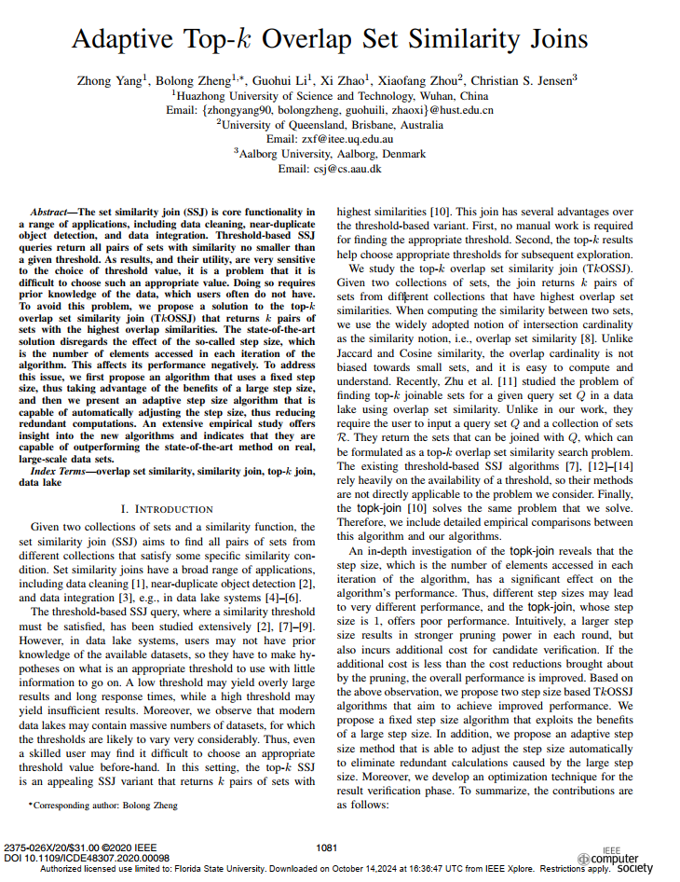
02
Summary of Paper 1
Adaptive Top-k Overlap Set Similarity Joins

Slide 6
Objective & Motivation
Adaptive Top-k Overlap Set Similarity Joins
Objective & Motivation
Problem:
Traditional Threshold-Based Set Similarity Joins (SSJ) require a threshold to return similar pairs, but: Selecting an appropriate threshold is challenging without prior knowledge of the data.Poorly chosen thresholds can lead to irrelevant or insufficient results.
Existing Solution:
Topk-Join Algorithm retrieves the top-k pairs of sets with the highest overlap similarity, eliminating the need for threshold selection.
Challenge:
As datasets grow larger, the efficiency of Topk-Join declines, creating a need for more scalable, adaptive methods.
Objective:
Develop an efficient and adaptive Top-k Overlap Set Similarity Join (TkOSSJ) method to handle large datasets effectively by: Reducing redundant computations.
Automatically adjusting to the dataset's characteristics to optimize performance.

Slide 7
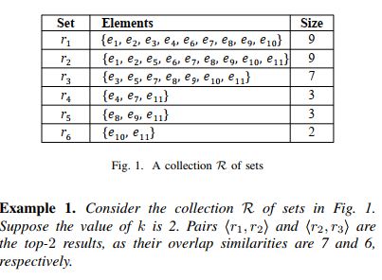
Top-K Concept
A Two-Level Signature Scheme for Stable Set Similarity Joins
Notes:
In Top-k Overlap Set Similarity Join. Top-K mean the most similar elements in a data set. K is a number. If K= 2, mean we need find the most 2 similar sets in a data set.

Slide 8
Topk-join
Key Components of Topk-Join
Priority Queue (PQ):
The algorithm uses a priority queue to manage “prefix events” for each set.
Prefix Events: <x,ei,pos,tub> tub = |X|-pos+1 <r1,e1,1,9>
Notes:
The basic Top-k Overlap Set Similarity Join Algorithm is Topk-join. Now I will show the details about it.
Purpose: The Topk-Join algorithm is designed to retrieve the top-k pairs of sets with the highest overlap similarity without requiring a predefined similarity threshold.
Where ei is the element at the positionof set x, and tub is the upper bound similarity that x could possibly achieve from pos to the end of x.
I will use an example to show the detail of this Algorithm.

Slide 9
Initial priority queue (PQ)
Store I(e1)
I(e1)
r1,e1,1,9
r2,e1,1,9
r3,e3,1,7
r4,e4,1,3
r5,e8,1,3
r6,e10,1,2
r1,e1,1,9
r2,e1,1,9
r1,e2,2,8
r3,e3,1,7
r4,e4,1,3
r5,e8,1,3
r6,e10,1,2
r1,e1,1,9
r1, e2, 2, 8
r2,e1,1,9
r1,e1,1,9
insert
Similarity = 7
(r1, r2) store in R
r2, e2, 2, 8
Notes:
Initialize Events:
For each set, create an initial prefix event based on its first element, and add it to the priority queue.
For first row, r1,e1,1,9. Because no elements can be found in I(e1). R1 is stored into it. Then the event for the current set is updated to the next element and inset in into priority queue.
Next step, we will work for second row.
the event for the current set is updated to the next element in the

Slide 10
r1,e1,1,9
r2,e1,1,9
r1,e2,2,8
r2,e2,2,8
r3,e3,1,7
r1,e3,3,7
r2,e5,3,7
r3,e5,2,6
r4,e4,1,3
r5,e8,1,3
r6,e10,1,2
r1,e1,1,9
r2,e1,1,9
r1,e2,2,8
r2,e2,2,8
r3,e3,1,7
r4,e4,1,3
r5,e8,1,3
r6,e10,1,2
r1,e1,1,9
r2,e1,1,9
r1,e2,2,8
r2,e2,2,8
r3,e3,1,7
r1,e3,3,7
r4,e4,1,3
r5,e8,1,3
r6,e10,1,2
r1,e1,1,9
r2,e1,1,9
r1,e2,2,8
r2,e2,2,8
r3,e3,1,7
r1,e3,3,7
r2,e5,3,7
r4,e4,1,3
r5,e8,1,3
r6,e10,1,2
Store I(e3)
r3,e3,1,7
r3,e5,2,6

Slide 11
r1,e1,1,9
r2,e1,1,9
r1,e2,2,8
r2,e2,2,8
r3,e3,1,7
r1,e3,3,7
r2,e5,3,7
r3,e3,2,6
r1,e4,4,6
r4,e4,1,3
r5,e8,1,3
r6,e10,1,2
r1,e1,1,9
r2,e1,1,9
r1,e2,2,8
r2,e2,2,8
r3,e3,1,7
r1,e3,3,7
r2,e5,3,7
r3,e5,2,6
r1,e4,4,6
r2,e6,4,6
r4,e4,1,3
r5,e8,1,3
r6,e10,1,2
r1,e1,1,9
r2,e1,1,9
r1,e2,2,8
r2,e2,2,8
r3,e3,1,7
r1,e3,3,7
r2,e5,3,7
r3,e5,2,6
r4,e4,1,3
r5,e8,1,3
r6,e10,1,2
r1,e4,4,6
I(e3)
Store I(e5)
r1,e3,3,7
r3,e3,1,7
r2,e6,4,6
r2,e5,3,7
Similarity = 5
(r1, r3) store in R tk = 5 < tub

Slide 12
r1,e1,1,9
r2,e1,1,9
r1,e2,2,8
r2,e2,2,8
r3,e3,1,7
r1,e3,3,7
r2,e5,3,7
r3,e5,2,6
r1,e4,4,6
r2,e6,4,6
r4,e4,1,3
r5,e8,1,3
r6,e10,1,2
r1,e4,4,6
I(e5)
R = {(r1,r2), (r2,r3)}
r3,e5,2,6
r2,e5,3,7
Similarity = 6
(r1, r3) store in R tk = 6 = tub =6 break
Notes:
The algorithm continues until the priority queue is empty or all sets in the queue have upper bounds lower than the k-th highest similarity.

Slide 13
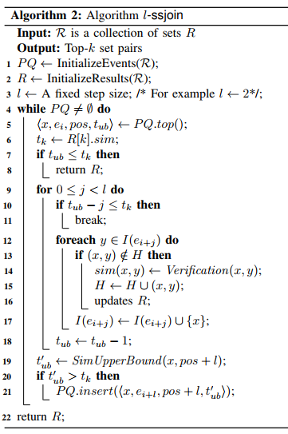
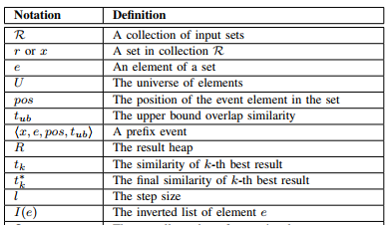
l-Step Size Method
A Two-Level Signature Scheme for Stable Set Similarity Joins
Inserting the initial prefix events of all sets.
For each set x, the initial prefix event is formed by its first element e1, i.e., 〈x, e1, 1, |x|〉
The sets are sorted in descending order of their sizes in the original PQ
Using a fixed-size heap to keep the best k results.
PQ: A priority queue
H: A hash table
Notes:
In this paper. Author proposed a new method.
Instead of accessing one element at a time in each iteration (like in Topk-Join), the l-Step Size Method allows the algorithm to access l elements of the set per iteration. Leading Faster Similarity Calculatio.

Slide 14
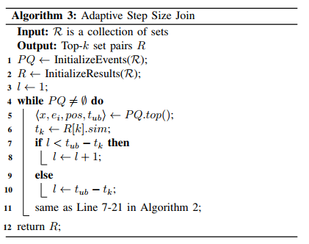
Adaptive Size Method
A Two-Level Signature Scheme for Stable Set Similarity Joins
The Adaptive Step Size Method (A-ssjoin) aims to further improve efficiency by automatically adjusting the step size l during each iteration. The step size l is to constant.
Increased Efficiency: Automatically adjusting 𝑙 helps the algorithm achieve the ideal balance between processing speed and computational cost.
Reduced Computational Overhead: Larger step sizes are only used when beneficial, and smaller steps prevent unnecessary calculations, reducing the overall workload.
Fewer Exceptional Cases: Exceptional cases, which occur when overly large steps lead to redundant checks, are minimized. This is especially useful in datasets with uneven or skewed distributions.

Slide 15
Real-world data
Notes:
This data set used in paper.

Slide 16
Experiments and Results-Evaluating The Step Size Based Methods
Adaptive Top-k Overlap Set Similarity Joins

Slide 17
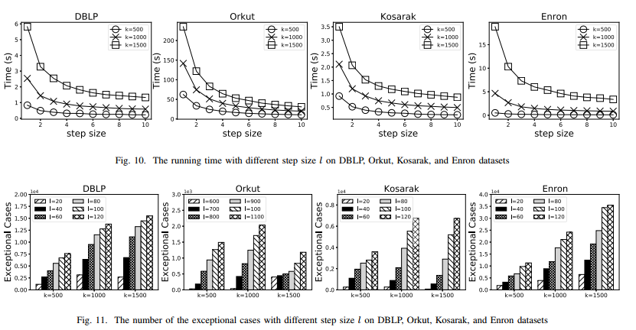
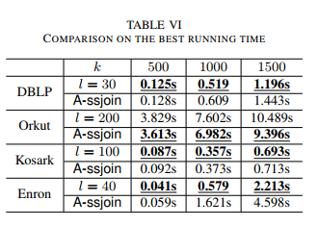
Experiments and Results-Evaluating The Step Size Selection
Adaptive Top-k Overlap Set Similarity Joins

Slide 18
Experiments and Results-Scalability on Data Size
Adaptive Top-k Overlap Set Similarity Joins

Slide 19
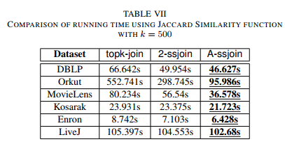
Experiments and Results-Evaluating Other Similarity Function
Adaptive Top-k Overlap Set Similarity Joins

Slide 20
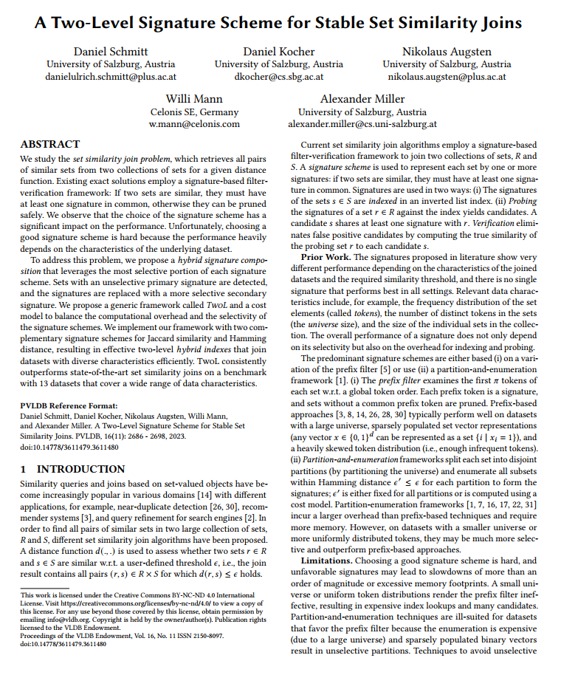
03
Summary of Paper 2
A Two-Level Signature Scheme
for Stable Set Similarity Join

Slide 21
Objective & Motivation
A Two-Level Signature Scheme for Stable Set Similarity Joins
Challenge: Existing set similarity join methods lack flexibility to handle diverse dataset characteristics, leading to high computational overhead and inefficiencies in candidate selection.
Two-level hybrid signature scheme: Leverages a flexible approach by using primary and secondary signatures, allowing the system to choose the most selective signatures based on data characteristics. TwoL balances performance and accuracy, making it effective across different types of datasets.
Notes:
Base signature framework dis

Slide 22
Signature-based Framework
Indexing Phase: Sets from the collection are represented by one or more signatures and stored in an inverted index. This index organizes sets by their signatures.
Probing Phase: To find similar sets for a query set, the framework probes the index by checking the signatures of the query set against those in the index. This yields a list of candidate sets that share at least one signature with the query set.
Verification Phase: After generating candidate pairs, the framework verifies each pair by calculating the actual similarity

Slide 23
Two-level hybrid
Notes:
If we construct a signature framework as shown in Figure A, many elements will share the same signature, leading to a high rate of false positives. However, increasing the number of signatures too much can lead to false negatives. To address this, the authors propose a new approach—a Two-Level Index for Hybrid Compositions. This method strategically combines two signature schemes across two levels, improving selectivity and reducing both false positives and false negatives.

Slide 24
Two-level hybrid
Primary Level:
Uses adaptable primary signatures for initial filtering to quickly eliminate non-similar pairs based on dataset properties.
Secondary Level:
Applies a flexible secondary signature scheme for precise matching, refining results from the primary level based on data needs
Secondary Index
Merged
Primary Index
Notes:
primary signature scheme to generate an initial set of signatures for each set in the dataset. If a primary signature sufficiently filters out non-similar sets, it remains in this primary index. The cycle mean this signature is less selective.
For sets where the primary signature is less selective. Secondary index using a different, more selective signature scheme. This second level helps manage cases where the primary index alone would result in a high number of candidate pairs
To reduce overhead, the framework may merge secondary indexes that share similar characteristics, optimizing storage and retrieval costs

Slide 25
Experiments and Results
A Two-Level Signature Scheme for Stable Set Similarity Joins
Runtime Comparison：
Overview: Shows CPU time for various algorithms across datasets using Hamming and Jaccard distances.
Key Points: TwoL (SS and MR) has consistently lower CPU times compared to others, especially as ϵ increases, showing better scalability and efficiency.

Slide 26
Experiments and Results
Memory Usage Comparison：
Overview: Compares memory usage for different algorithms on multiple datasets with varying ϵ\epsilonϵ values.
Key Points: TwoL maintains low memory usage across thresholds, outperforming other methods like fcLSH and PARTAlloc, which use significantly more memory as ϵ\epsilonϵ increases.

Slide 27
Contribution
A Two-Level Signature Scheme for Stable Set Similarity Joins
Hybrid Signature Composition: Combines prefix-based and partition-and-enumeration signatures to improve selectivity and reduce candidate pairs across diverse datasets.
Adaptability: Dynamically adjusts to different dataset characteristics, maintaining high efficiency on varied token distributions and set sizes.
Optimized Resource Usage: Minimizes memory and computational costs by applying secondary signatures only when primary signatures are insufficiently selective.

Slide 28
04
Integration

Slide 29
Feasibility of Combining TkOSSJ and TwoL
Complementary Strengths:
TkOSSJ offers adaptive top-k selection, ideal for scenarios without a clear similarity threshold.
TwoL provides stable, two-level filtering, which adapts to various data distributions, making it efficient across diverse datasets.
Integration Potential:
Combining these methods allows top-k selection to leverage TwoL’s filtering, effectively reducing the candidate set.
Adaptive step size in TkOSSJ can optimize performance within TwoL’s layered structure.
Outcome: The combined approach balances efficiency and adaptability, making it feasible for both exploratory analysis and precise threshold-based queries.

Slide 30
Steps to Combine Methods
Two-Level Structure with Top-k Filtering:
Use TwoL’s primary signature to filter candidates.
Apply TkOSSJ’s top-k selection to retrieve the k most similar pairs.
Adaptive Step Size:
Integrate TkOSSJ’s adaptive step size to enhance efficiency within TwoL’s secondary filtering.
Mode Selection:
Choose Threshold Mode for precise matches, Top-k Mode for exploratory analysis.

Slide 31
Advantages of the Combined Method
Increased Efficiency: Multi-level filtering + adaptive top-k selection reduce runtime.
Enhanced Flexibility: Supports threshold-based and top-k queries, adaptable to data characteristics.
Broader Application: Suitable for data cleaning, duplicate detection, and large-scale data exploration.

Slide 32
Reference
Adaptive Top-k Overlap Set Similarity Joins
Conference/Journal: 2020 IEEE 36th International Conference on Data Engineering (ICDE)
Authors: Zhong Yang, Bolong Zheng, Guohui Li, Xi Zhao, Xiaofang Zhou, Christian S. Jensen
Year: 2020
A Two-Level Signature Scheme for Stable Set Similarity Joins
Conference/Journal: Proceedings of the VLDB Endowment (VLDB)
Authors: Daniel Schmitt, Daniel Kocher, Nikolaus Augsten, Willi Mann, Alexander Miller
Year: 2023

Slide 33
Thanks

Slide 34
Q & A

