Slide 1
Advanced Data Mining (CAP 5778)
Paper Presentation

Slide 2
Are all GANs created equal? A large-scale study
Saransh Bogati
Deepak Dulal
Teme Oketete
Notes:
Good Morning everyone. I am here with my friend Saransh and Teme , and we are presenting the paper about GANs. the paper is titled "Are all GANs created equally?, A Large Scale Study.

Slide 3
Problem Definition
GANs are powerful, but which one performs best?
Are some GAN algorithms consistently better than others?
Evaluating GAN is challenging.
Notes:
The paper looks at an important question: Are some GAN algorithms always better than others? GANs are very powerful, but it's hard to evaluate how good they are. The ways to measure their performance are limited, and people often rely on personal opinions to judge the results. Comparing different GAN models is also tricky. This study tries to solve these problems by analyzing GAN performance on a large scale.

Slide 4
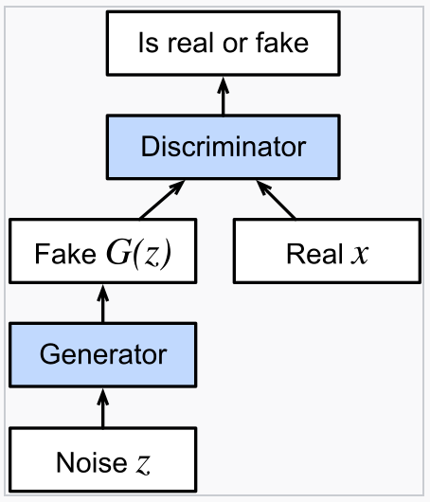
What are GANs?
Generative adversarial network (GAN) is a class of machine learning frameworks and a prominent framework for approaching generative artificial intelligence.
Generator: Creates fake samples.
Discriminator: Distinguishes real vs fake samples.
Notes:
GANs consist of two components: the generator and the discriminator. The generator tries to create data that mimics the real data, while the discriminator attempts to differentiate between real and fake samples. Imagine an art forger trying to fool an art expert—that’s essentially how GANs work!
GANs, (Generative Adversarial Networks are frameworks in machine learning that excel in generative artificial intelligence tasks. GANs consist of two neural networks: a generator and a discriminator. The generator creates fake samples, such as images, while the discriminator works to distinguish between real and fake samples.
Imagine an art forger trying to fool an art expert—that’s essentially how GANs work!

Slide 5
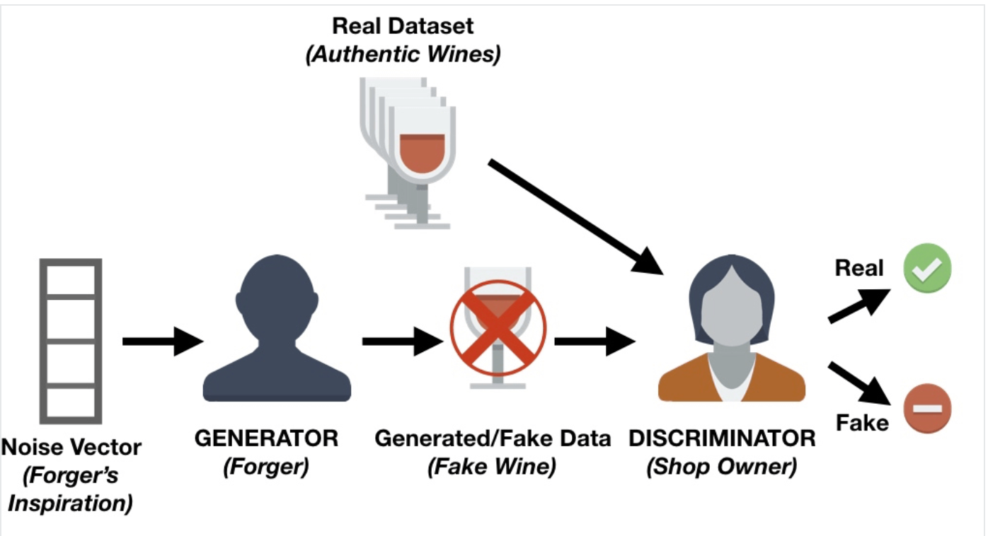
Wine forger vs Wine expert
.
Ref: datacamp.com/tutorial/generative-adversarial-networks
Notes:
To explain the concept of GANs, let’s use the example of a wine shop.
Imagine a shop that buys wine from customers to resell later. However, some dishonest customers try to sell fake wine to make money. The shop owner must be able to tell the difference between fake and authentic wines.
Initially, it’s easy for the shop owner to identify fake wine because the forger’s techniques are poor. But as the forger learns from their mistakes, they develop better methods to make their fake wine resemble the authentic ones.
At the same time, the shop owner might receive feedback from experts or other shop owners about wines they mistakenly accepted. Using this feedback, the shop owner improves their ability to detect fake wines.
This creates a back-and-forth competition:
The forger’s goal is to create fake wines that are indistinguishable from authentic ones.
The shop owner’s goal is to accurately detect whether a wine is real or fake.
This dynamic competition is the key idea behind GANs.
Now, let’s connect this to GANs:
The forger represents the generator network. It generates fake samples (like fake wine) to mimic real ones.
The shop owner represents the discriminator network. Its job is to distinguish real samples from the fake ones.
Both networks are typically convolutional neural networks, especially since GANs are widely used for image tasks. The discriminator assigns a probability that an image is real, while the generator starts with random noise and creates images.
During training, the generator learns how to improve its images to fool the discriminator, while the discriminator keeps learning to get better at spotting the fake ones.
The ultimate goal is for the generator to produce images that are so realistic that the discriminator cannot tell them apart from real ones. This adversarial process leads to a generative network capable of creating highly realistic images."

Slide 6
Purpose of GANs
Image generation: Synthesizing realistic image.
Data augmentation: Enriching datasets.
Domain transfer: Applications like sketch to image.
Notes:
GANs have a wide range of applications that make them extremely valuable in the field of artificial intelligence.
Creating images: GANs can generate highly realistic images, such as creating lifelike human faces or objects that don’t exist in real life. This is particularly useful in industries like entertainment and advertising, where realistic visuals are essential.
Improving datasets (Data augmentation): In scenarios where there is limited data, GANs can generate additional examples that resemble the original data. This helps improve the performance of machine learning models by providing them with more varied and representative training data.
Transforming images (Domain transfer): GANs can convert images from one form to another. For example, they can turn a rough sketch into a detailed, realistic image or change the style of an image, like transforming a summer landscape into a snowy winter scene. They are also used for tasks like turning black-and-white photos into color.
These abilities make GANs a central tool in generative AI research and applications, enabling advancements in creativity, automation, and solving real-world challenges.

Slide 7
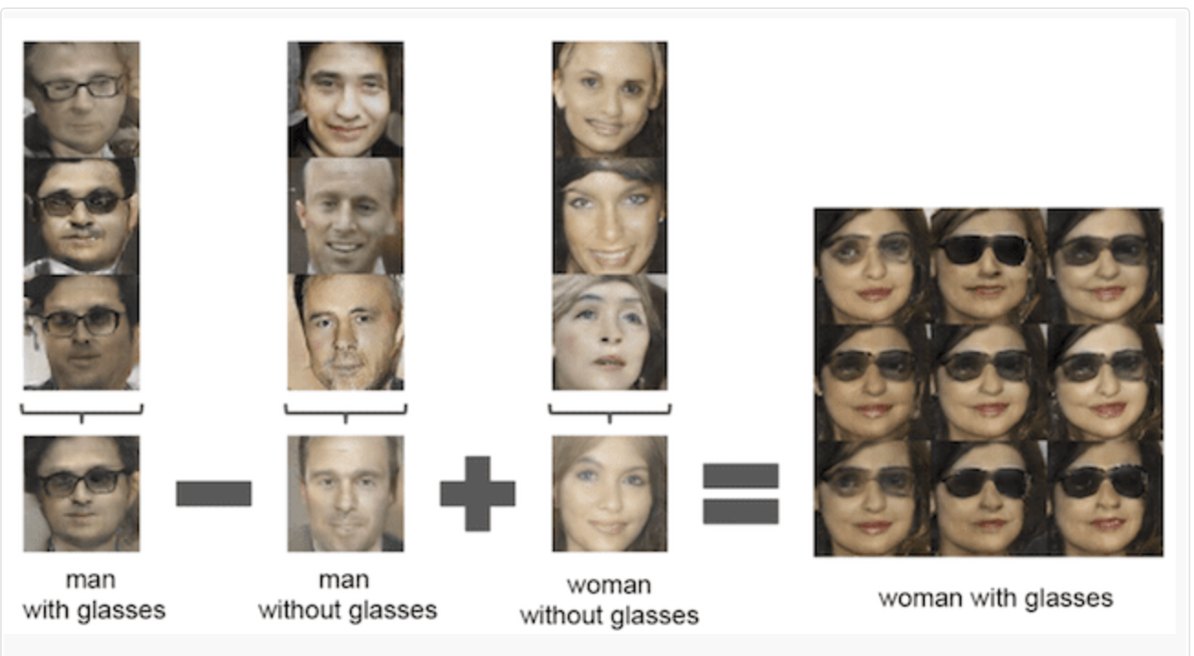
Example: Image Generation
.
Ref: https://machinelearningmastery.com/impressive-applications-of-generative-adversarial-networks/
Notes:
There are several types of GANs. The Original GAN uses binary cross-entropy loss, while Wasserstein GAN minimizes the Wasserstein distance, improving stability. Least Squares GAN penalizes outliers heavily, and BEGAN introduces a balance mechanism using autoencoders. Each has unique strengths and challenges.

Slide 8
Types of GANs
Original GAN: Binary cross-entropy loss
Wasserstein GAN: Optimizes Wasserstein distance.
Least Squares GAN: Penalizes outliers with squared error.
BEGAN: Balances generator and discriminator using autoencoder loss.
Notes:
There are different types of GANs, each created to solve specific problems and improve performance:
Original GAN: This was the first type of GAN, using a basic method called binary cross-entropy loss. It laid the foundation for all other GANs.
Wasserstein GAN (WGAN): This type improves training stability by using the Wasserstein distance, which is a better way to measure how close the generated data is to the real data.
Least Squares GAN (LSGAN): This GAN reduces the effect of extreme errors by using squared error loss, making it more robust to outliers.
BEGAN: This version balances the generator and discriminator by using an autoencoder-based loss, which helps both components work better together.
Each type builds on earlier models to improve how GANs create realistic and high-quality data. These variations make GANs more adaptable and effective for different tasks.

Slide 9
Evaluation Metrics
Fréchet Inception Distance (FID):
Primary metric.
Real vs. fake data distribution by comparing mean & covariance in feature space
Lower = Better resemblance.
Precision: Measures the sample quality.
Recall: Measures the sample diversity.
Notes:
Inception Score evaluates diversity and quality by measuring entropy. High-quality samples with diverse outputs score well. FID, on the other hand, measures how close the generated data distribution is to the real data. A lower FID score indicates better resemblance to the original data distribution

Slide 10
Main Experiment Setup
Common architecture: Based on INFO GAN and DCGAN for fairness.
Exception: BEGAN uses an autoencoder as a discriminator.
2. Hyperparameter optimization:
Wide search: 100 samples, broad parameter ranges.
Narrow search: 50 samples, refined from initial results.
3. Datasets: Simple to medium complexity: MNIST, Fashion MNIST, CIFAR-10, CELEBA.
4. Computational budget:
Experiments were conducted under varying budgets to evaluate their impact on GAN performance.
Budget sizes influenced the depth of hyperparameter searches (e.g., wide vs. narrow search) and training duration.
Notes:
Moving onto the main experiments that were conducted in the paper. The study maintained fairness by having a common architecture across all models. The architecture is based on INFO GAN and DCGAN, which are widely used for research in GAN. However, for BEGAN an autoencoder is used as a discriminator to align its structure with its unique optimization strategy.
Two types of hyperparameter searches were conducted:
Wide Search: In this phase, 100 samples of hyperparameters are explored across a broad range to identify general trends.
Narrow Search: This focuses on 50 samples with tighter ranges refined from the wide search, ensuring efficiency without sacrificing performance.
Now the datasets used in this study varied in complexity ranging from simple to medium complexity.
MNIST and Fashion MNIST: These are simpler datasets often used as benchmarks for generative models.
CIFAR-10 and CELEBA: These add medium complexity and higher diversity, challenging the models to generalize better.
Computational budgets were intentionally varied to analyze their impact on GAN performance. Models trained with higher budgets had access to more extensive hyperparameter searches and longer training cycles, allowing us to evaluate how these factors influence robustness and consistency.

Slide 11
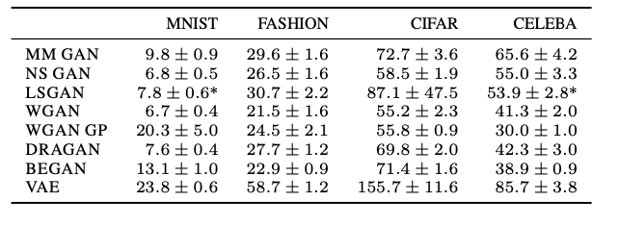
Key Findings
Similar FID Scores with Tuning:
Performance depends more on hyperparameter optimization than algorithmic design.
Wide hyperparameter searches significantly improve results.
Computational Budget Matters:
Higher budgets enable better tuning and longer training, often allowing weaker models to outperform stronger ones.
Comparisons with limited budgets are often unreliable.
Impact of Limited Budgets:
Narrow hyperparameter ranges work well for robust models (e.g., NS GAN) but fail for sensitive ones (e.g., WGAN).
Resource constraints lead to increased performance variance across datasets.
Robustness to Random Initialization:
Most models are stable, but some (e.g., LSGAN) show high variance due to initialization.
Multiple training runs are required for fair and reliable comparisons.
Table: Best FID obtained in a large-scale hyperparameter search for each data set.
Notes:
1. Similar FID Scores with Tuning:
One of the most significant findings is that most GAN models can achieve similar FID scores when hyperparameters are carefully tuned. This suggests that algorithmic differences may not matter as much as the effort spent on optimization.
For example, wide hyperparameter searches, where a large parameter space is explored, consistently improve performance. However, this comes at a computational cost, which is critical in real-world applications.”
2. Computational Budget Matters:
A higher computational budget enables more extensive hyperparameter tuning and longer training cycles. This often allows even weaker models, or those considered ‘bad,’ to outperform well-designed models when computational resources are limited.
Low-budget comparisons, on the other hand, are unreliable because they fail to capture the full potential of each model. As seen in the table, models like NS GAN and LSGAN show large performance improvements when given enough budget.”
3. Limited Budget Impact:
When the budget is limited, narrow hyperparameter ranges, which are derived from earlier wide searches, are used. These work well for some models, like NS GAN, which are less sensitive to parameter settings.
However, models like WGAN perform poorly under constrained budgets due to their higher sensitivity to precise tuning. This highlights the need for fair budget allocation when comparing models across datasets.
4. Robustness to Random Initialization:
Finally, we observe variability in performance due to random initialization of the generator and discriminator weights. While most models remain stable across different seeds, some, like LSGAN, show high variance.

Slide 12
Results
Notes:
Computational budget significantly impacts model performance
NS GAN and WGAN generally outperform other models across metrics
BEGAN shows inconsistent performance across different metrics
Most models show diminishing returns after budget=40
Higher precision than recall across all models suggests they prioritize quality over diversity

Slide 13
Key Challenges in Evaluating GANs
No explicit probability computation: Traditional evaluation methods are infeasible.
Subjective visual assessments: Human evaluation is biased and inconsistent.
Metric limitations:
IS: Ignores overfitting and prior distributions.
FID: Can’t detect overfitting; vulnerable to artifacts.
Hyperparameter sensitivity: Performance depends heavily on dataset-specific tuning.
Optimization challenges: Complex datasets need larger models and precise tuning.
Notes:
No explicit probability computation:
• “Unlike traditional generative models, GANs don’t produce explicit probability distributions for their outputs. This makes standard evaluation methods, like likelihood estimation, infeasible. We cannot directly quantify how well the generated data matches the real data probabilistically.”
2. Subjective visual assessments:
• “In many cases, GAN performance has been judged based on the visual quality of the generated images, evaluated by humans. This method is inconsistent and introduces bias since it’s based on personal perception rather than an objective standard.”
3. Metric limitations:
• IS (Inception Score):
• “While IS measures the diversity and quality of generated samples, it fails to detect overfitting. A model that memorizes training data could still score well on IS, and it doesn’t account for prior distributions of labels.”
• FID (Fréchet Inception Distance):
• “FID compares real and generated data distributions in a feature space. However, it also has drawbacks—it cannot detect overfitting, and its results are sensitive to artifacts specific to the encoding network used during evaluation.”
4. Hyperparameter sensitivity:
• “GANs are highly sensitive to hyperparameter settings such as learning rate, batch size, and regularization parameters. Performance can vary significantly across datasets, meaning hyperparameters optimized for one dataset might not work for another.”
5. Optimization challenges:
• “Training GANs on complex datasets requires larger models and precise tuning. This makes optimization more difficult, as the generator and discriminator networks need to stay balanced throughout training to prevent issues like mode collapse or divergence.”

Slide 14
Data Augmentation for GANs
Challenge: Limited data in some domains.
Solution: DAG aligns augmented data learning with original distribution.
Notes:
This now gives room for us to transition to the other research paper covered in our study which entails Data Augmentation for GANs.
Data Augmentation (DA) increases the size of the dataset to reduce the over-fitting and generalizes the learning of deep neural networks.
An issue however with classical data augmentation is that the use of augmented data can lead to loss of the original distribution. Lets take a look at this Toy example from the paper
Data scarcity in some domains limits GAN training. Classical data augmentation changes the data distribution, which misguides the GAN. The DAG framework addresses this by aligning the learning of augmented and original data distributions.
Training the discriminator (regarded as a binary classifier) using augmented samples tends to improve generalization of discriminator learning: i.e., by increasing feature invariance (regarding real vs. fake) to specific transformations, and penalizing model complexity via a regularization term based on the variance of the augmented forms [

Slide 15
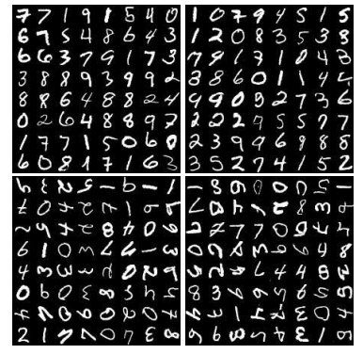
Toy Example
Data Augmentation Techniques used:
Rotation
Flipping
Cropping
Notes:
This example was set up with the MNIST dataset for the illustration. And in the experiment, the original MNIST data set was augmented with some widely-used augumentation techniques such as (Rotation, Flipping, and cropping) to obtain a new dataset and then training the standard GAN on the new dataset.
The results form this experiment was that as you can observe, the generators trained with DA methods created samples like the augmented distribution. For this reason, the FID score for the Augmented Data is much higher than that of the original dataset which means it performed much more poorly in terms of comparison with the original distribution. This means that if classic data augmentation was used for GAN training, one could encounter an issue of infrequent samples being generated more due to the alternation in the original data distributions
From this experiment
Rotation: Rotating an image by a certain angle (e.g., ±10°).
Flipping: Horizontal and/or vertical flipping
Cropping a random region of the image and resizing it to the original dimensions, introducing variability in the visible content.

Slide 16
Toy Example
FID scores of original dataset vs augmented dataset
Notes:
As you can see from this diagram, the FID score for the Baseline which is simply GAN trained using original is much lower than the Datasets with augmentations . For this reason a new principle framework, Data Augmentation Optimized for GAN (DAG) was proposed

Slide 17
DAG Framework
Multiple discriminators for transformed data.
Weight sharing to preserve original distribution.
Invertible transformations ensure theoretical guarantees.
Notes:
The DAG framework uses multiple discriminators, each trained on transformed data. Weight sharing across discriminators improves generalization while preserving the original data distribution. Invertible transformations ensure theoretical guarantees for learning consistency.
In simpler terms, the DAG framework makes exploits Discriminator regularization which is simply instead of one discriminator, the model has many discriminators, each trained on a specific data, and they share information with each other

Slide 18
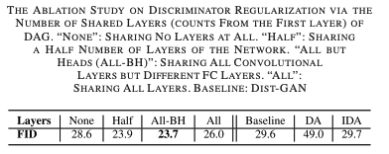
Does DAG Work?
.
Notes:
So in order to test that Data augmentation optimized for GANs would actually perfom and give vailble results, an experiment was conducted to investigate the influence of DAG across various augmentation techniques on two state-of-the-art baseline models: Dist-GAN [39] for unconditional GAN and SS-GAN [50] for self-supervised GAN.
From an ablation study, it was uncovered that

Slide 19
Does DAG Work?
Notes:
So in order to test that Data augmentation optimized for GANs would actually perfom and give vailble results, an experiment was conducted to investigate the influence of DAG across various augmentation techniques on two state-of-the-art baseline models: Dist-GAN [39] for unconditional GAN and SS-GAN [50] for self-supervised GAN.
From an ablation study, it was uncovered that

Slide 20
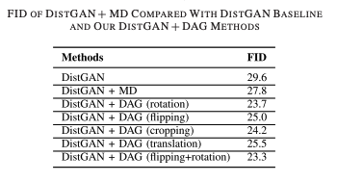
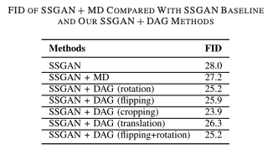
Does DAG Work?
Notes:
So in order to test that Data augmentation optimized for GANs would actually perfom and give vailble results, an experiment was conducted to investigate the influence of DAG across various augmentation techniques on two state-of-the-art baseline models: Dist-GAN [39] for unconditional GAN and SS-GAN [50] for self-supervised GAN.
From an ablation study, it was uncovered that

Slide 21
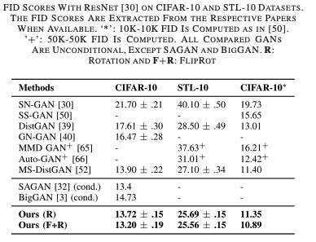
Does DAG Work?
.
Notes:
So in order to test that Data augmentation optimized for GANs would actually perfom and give vailble results, an experiment was conducted to investigate the influence of DAG across various augmentation techniques on two state-of-the-art baseline models: Dist-GAN [39] for unconditional GAN and SS-GAN [50] for self-supervised GAN.
From an ablation study, it was uncovered that

Slide 22
Possible Improved Comparison?
Clearer & more distinct FID scores between GAN Models
Better & Improved dataset
Notes:
While DAG does not directly address all the limitations like architecture size or hyperparameter optimization, it can mitigate some of the data-related challenges that contribute to the issues described, such as overfitting, inconsistent training, and poor generalization. By improving the data used in training, DAG helps the generator and discriminator learn more effectively, leading to more stable and reliable model performance. This makes it easier to compare GAN models across datasets and architectures, particularly when dealing with higher resolution or more complex data.

Slide 23
Conclusion & Key Takeaways
GANs are sensitive to hyperparameters.
Computational budget is critical for comparisons.
DAG enhances GANs in limited-data scenarios.
DAG could improve comparison parameters for GANs
Notes:
n conclusion, GAN performance is highly sensitive to hyperparameters and computational resources. Fair comparisons require equal computational budgets. In low-data scenarios, DAG effectively enhances GAN performance by leveraging data augmentation in a principled manner.

Slide 24
Thank you!
.

