Slide 1
CAP5778 Advanced Data Mining
Advertising on the Web
Peixiang Zhao
Florida State university
Part of the course materials are adapted or revised from Mining of Massive Datasets (mmds.org)

Slide 2
Online Algorithms
Classic model of algorithms
You get to see the entire input, then compute some function of it
Also known as “offline algorithm”
Online Algorithms
You get to see the input one piece at a time, and need to make irrevocable decisions along the way
Similar to the data stream model

Slide 3
Bipartite Matching
Boys
Girls
1
a
2
b
3
c
4
d
A bipartite graph G
Nodes: Boys and Girls; Edges: Preferences
Goal: Match boys to girls so that the maximum number of preferences (edges) is satisfied

Slide 4
Bipartite Matching
Boys
Girls
1
a
2
b
3
c
4
d
M = {(1,a),(2,b),(3,d)} is a matching
Cardinality of matching:|M| = 3

Slide 5
Bipartite Matching
Boys
Girls
1
a
2
b
3
c
4
d
M = {(1,c),(2,b),(3,d),(4,a)} is a perfect matching
Perfect matching: all vertices of the graph are matched
Maximum matching: a matching that contains the largest possible number of matches

Slide 6
Bipartite Matching Algorithm
Problem: Given as input a bipartite graph G, find a maximum matching for G
Or a perfect matching if it exists
Polynomial-time solvable based on the Ford-Fulkerson algorithm for the maximum flow problem
Add a source node and the edges from the source to all boy nodes; Add a sink node and the edges from all girl nodes to the sink. The capacity of every edge is 1
The maximum flow is actually the maximal bipartite matching
Time complexity: O(V*E)
What if we do not know the entire graph upfront?

Slide 7
Online Graph Matching Problem
Problem Setting
Initially, we are given the set boys
In each round, one girl’s choices are revealed
That is, girl’s edges are revealed
At that time, we have to decide to either:
Pair the girl with a boy
Do not pair the girl with any boy
Example of application:
Assigning tasks to servers

Slide 8
Online Graph Matching
1
a
(1,a)
2
b
(2,b)
3
c
(3,d)
4
d

Slide 9
Online Graph Matching: Greedy Solution
The Greedy scheme
Pair the new girl with any eligible boy
If there is none, do not pair the girl
How good is the algorithm?
Competitive ratio
For input I, suppose greedy produces matching M_{greedy} while an optimal matching is M_{opt}
The greedy’s worst performance over ALL possible inputs I
Competitive ratio = min_{all possible inputs I} (|M_{greedy}|/|M_{opt}|)

Slide 10
The Greedy Algorithm: Analysis
Consider a case: M_{greedy}≠ M_{opt}
Consider the set G of girls matched in M_{opt} but not in M_{greedy}
Then every boy B adjacent to girls in G is already matched in M_{greedy}:
Otherwise, If there would exist such non-matched boy (by M_{greedy}) adjacent to a non-matched girl then greedy would have matched them: contradiction
Since boys B are already matched in M_{greedy} then
|M_{greedy}|≥ |B| (1)
M_{opt}
1
a
M_{greedy}
2
b
3
c
4
d
B={ }
G={ }

Slide 11
The Greedy Algorithm: Analysis
There are at least |G| such boys (|G| ≤ |B|); otherwise, the optimal algorithm couldn’t have matched all girls in G
So: |G| ≤ |B| ≤ |M_{greedy}| (2)
By definition of G also:
|M_{opt}| ≤ |M_{greedy}| + |G|
Worst case is when |G| = |B| = |M_{greedy}|
Based on (2), we note
|M_{opt}| ≤ |M_{greedy}| + |G| ≤ 2|M_{greedy}|
then |M_{greedy}|/|M_{opt}| ≥ 1/2
M_{opt}
1
a
M_{greedy}
2
b
3
c
4
d
B={ }
G={ }

Slide 12
The Worst-case Scenario
1
a
(1,a)
2
b
(2,b)
3
c
4
d

Slide 13
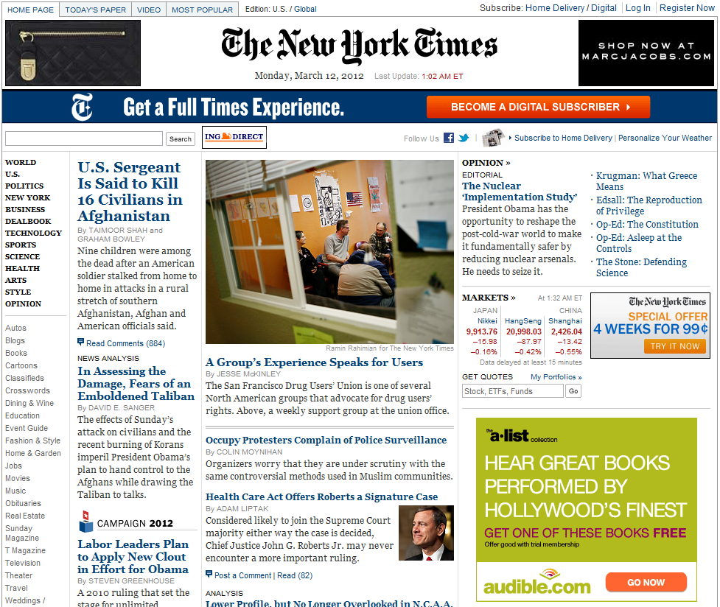
Web Advertising
Banner ads (1995-2001)
Initial form of web advertising
Popular websites charged $X for every 1,000 “impressions” of the ad
Called “CPM” rate (Cost per thousand impressions)
Modeled similar to TV, magazine ads
Low click-through rates
A performance metric that measures how often people click on an ad. relative to how many times it is shown
Low ROI (Return On Investment) for advertisers

Slide 14
Performance-based Advertising
Advertisers bid on search keywords
When someone searches for that keyword, the highest bidder’s ad is displayed
Advertiser is charged only if the ad is clicked on
Adwards: similar model adopted by Google around 2002
Performance-based advertising works!
Multi-billion-dollar industry nowadays
Interesting problem:
What ads to show for a given query?
If I am an advertiser, which search terms should I bid on and how much should I bid?

Slide 15
Performance-based Advertising
Search Engine
Users
Queries
(online)
Bidding
(offline)
Advertisers
Find matching candidates
Score candidates
Run auction

Slide 16
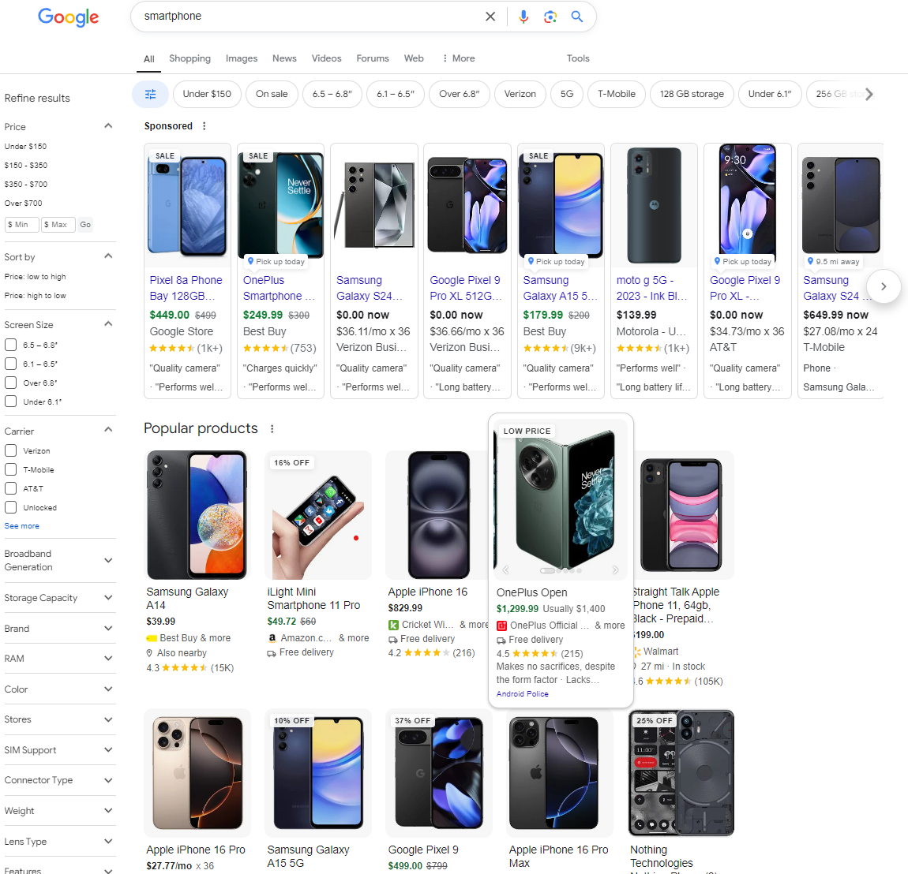
Example

Slide 17
The Adwords Problem
Given as input:
A set of bids by advertisers for search queries
A click-through rate (CTR) for each advertiser-query pair
A budget for each advertiser (say for 1 month)
A limit on #ads to be displayed with each search query
Respond to each search query with a set of advertisers such that:
The size of the set is no larger than the limit on #ads per query
Each advertiser has bid on the search query
Each advertiser has enough budget left to pay for the ad if it is clicked upon

Slide 18
The Adwords Problem
The Problem Setting
A stream of queries arrives at the search engine: q₁, q₂, …
Several advertisers bid on each query
When query q_{i} arrives, search engine must pick a subset of advertisers whose ads are shown
Goal: Maximize search engine’s revenues
Simple solution: Instead of raw bids, use the “expected revenue per click” (i.e., Bid*CTR)
Clearly we need an online algorithm!
Queries are endless and unknown
The budget of an advertiser is limited and unknown
CTR of an ad is unknown (thus measured historically)

Slide 19
The Adwords Problem
Advertiser
Bid
CTR
Bid * CTR
A
$1.00
1%
1 cent
B
$0.75
2%
1.5 cents
C
$0.50
2.5%
1.125 cents
Advertiser
Bid
CTR
Bid * CTR
B
$0.75
2%
1.5 cents
C
$0.50
2.5%
1.125 cents
A
$1.00
1%
1 cent

Slide 20
The Greedy Solution
Simplified setting:
There is ONE ad shown for each query
All advertisers have the same budget B
All ads are equally likely to be clicked
Value (Expected revenue per click) of each ad is the same (=1)
The simplest algorithm is greedy:
For a query pick ANY advertiser who has bid 1 for that query
Competitive ratio of the greedy solution is 1/2

Slide 21
The Worst-case Scenario
Consider two advertisers A and B
A bids on query x, B bids on x and y
Both have budgets of $4
Query stream is like x x x x y y y y ……
Consider a greedy choice: B B B B _ _ _ _
Optimal: A A A A B B B B
Competitive ratio = 1/2
This is the worst case!
A
x
B
y

Slide 22
Can We Do Better?
The BALANCE algorithm
For each query, pick the advertiser with the largest unspent budget
Break ties arbitrarily (but in a deterministic way)
Consider two advertisers A and B
A bids on query x, B bids on x and y
Both have budgets of $4
Query stream is like x x x x y y y y ……
BALANCE choice: A B A B B B _ _
Optimal: A A A A B B B B
For BALANCE on 2 advertisers, The competitive ratio = 3/4
A
x
B
y

Slide 23
The BALANCE Algorithm
Consider, w.l.o.g., a simple case:
Two advertisers, A₁ and A₂, each with budget B (≥1)
Optimal solution exhausts both advertisers’ budgets
BALANCE must exhaust at least one advertiser’s budget:
If NOT:
There would be some query assigned to neither A₁ and A₂
However, both A₁ and A₂ still have budget
At least one advertiser bids on each query, because that query is assigned in the optimal algorithm
Contradiction: BALANCE always assigns a query if it can
Assume BALANCE exhausts A₂’s budget, but allocates x queries fewer than the optimal
Revenue: BAL = 2B - x
B
A₁
A₂
Optimal Solution

Slide 24
The BALANCE Algorithm
Queries allocated to A₁ in the optimal solution
B
Queries allocated to A₂ in the optimal solution
Optimal revenue = 2B
Assume BALANCE gives revenue = 2B-x = B+y
A₁
A₂
x
Unassigned queries should be assigned to A₂
(if we could assign to A₁ we would since we still have budget)
Goal: Show we have y ≥ x
Consider blue queries (A₁ by OPT ) in A₁ and A₂ Case 1) ≥ ½ of blue queries (B) is assigned to A₁ then $y \text{≥} B/2$, so surely $y \text{≥ }x$
Case 2) > ½ of blue queries is assigned to A₂
then $x≤B/2$ and $x+y=B$
Balance revenue is minimum for $x=y=B/2$
Minimum Balance revenue = $3B/2$
Competitive Ratio = 3/4
B
y
x
A₁
A₂
Not used
x
B
y
x
q
A₁
A₂
Notes:
Case 2) q is the LAST query of the blue queries assigned by BALANCE to A₂. Before the assignment, A2 must have had at least as great a budget available as A1, or else BALANCE would have assigned query q to A1. Further, before the assignment of q, the remaining budget of A2 was at most B/2 ($≤B/2$, Otherwise the remaining budget of A2 (>B/2) plus the last query q won’t account the fact that more than ½ of blue queries got assigned to A2.
Therefore, at that time, the remaining budget of A1 ≤ the remaining budge of A2 $≤B/2$. So x ≤ B/2. It follows that y ≥ x, since x + y = B.

Slide 25
BALANCE: The General Case
N advertisers: A₁, A₂, … A_{N}, Each with budget B > N
Queries: N∙B queries appear in N rounds of B queries each
Bidding:
Round 1 queries: bidders A₁, A₂, …, A_{N}
Round 2 queries: bidders A₂, A₃, …, A_{N}
Round i queries: bidders A_{i}, …, A_{N}
Optimum allocation: Allocate round i queries to A_{i}
The optimum revenue N∙B
……
B
A₁
A₂
A₃

Slide 26
BALANCE Allocation
…
B/(N-2)
B/(N-1)
B/N
A₁
A₂
A₃
A_{N-1}
A_{N}
BALANCE assigns queries in round 1 to N advertisers, queries in round 2 to N-1 advertisers, ……
After k rounds, sum of allocations to each of advertisers A_{k},…,A_{N} is $S_{k}= S_{k+1}=…=S_{N}=\sum_{i=1}^{k}{\frac{B}{N−(i−1)}}$
If we find the smallest k such that S_{k} ≥ B, then after k rounds, we cannot allocate any queries to any advertiser

Slide 27
BALANCE Allocation
At the lowest round k such that
$$B\left(\frac{1}{N}+\frac{1}{N−1}+…+\frac{1}{N−k+1}\right)≥B.$$
That is,
$$\frac{1}{N}+\frac{1}{N−1}+…+\frac{1}{N−k+1}≥1.$$
Approximately,
$$lnN−\ln\left(N−k\right)≥1 \left(because \sum_{i=1}^{k}{\frac{1}{i} ≈lnk}\right)$$
So,
$$k=N(1−\frac{1}{e})$$
The approximate revenue by BALANCE is BN(1 − 1/e), and the competitive ratio is 1 − 1/e, or approximately 0.63

Slide 28
Thank you

