Slide 1
Introduction to the Mathematics of Regression Part 1
by
for
Introduction to Artificial Intelligence (CAP 4601)

Slide 2
Agenda
Sum of Parabolas
Minima: Weighted Sample Mean
Sample Mean
Sum of Squared Differences, Biased Sample Variance, and Unbiased Sample Variance
Biased and Unbiased Sample Standard Deviation
Sum of 2D Parabolas
2D Sample Mean
Sum of the Product of Differences, Biased Sample Covariance, and Unbiased Sample Covariance
Line
Linear Regression
Minima: Sum of Squared Differences and Sum of the Product of Differences
Independent Variable Bias
Online Mean
One Way To Program Simple Linear Regression

Slide 3
Data
Given: { 0.255193, 2.23273, 3.85555, 4.49383, 4.90807, 6.24521, 6.41867, 8.09172, 8.61902, 9.39342 }

Slide 4
Parabola

Slide 5
Parabolas
For each datum, place a parabola centered on that value.

Slide 6
Sum of Parabolas

Slide 7
Sum of Parabolas

Slide 8
Minima: Weighted Sample Mean

Slide 9
Minima: Weighted Sample Mean

Slide 10
Sample Mean

Slide 11
Sample Mean

Slide 12
Sample Mean

Slide 13
Sum of Parabolas: Sum of Squared Differences

Slide 14
Sum of Parabolas: Biased Sample Variance

Slide 15
Sum of Parabolas: Unbiased Sample Variance

Slide 16
Biased and Unbiased Sample Variance

Slide 17
Sample Standard Deviation
Biased:
Unbiased:

Slide 18
Data
Data: { {-2.70238,2.43155}, {-2.18612,1.63634}, {0.405141,3.84976}, {-1.03072,2.7144}, {1.10033,2.89639}, {-1.63906,2.56916}, {2.27983,4.57127}, {-0.836348,2.70824}, {-2.90988,0.685828}, {-0.104817,2.95222}, {-0.226538,2.24849}, {-2.64364,1.28981}, {-0.00953108,2.84022}, {0.336282,3.86626}, {4.12633,5.94993}, {1.70053,4.51368}, {-1.4793,1.99986}, {0.0467884,3.91811}, {-1.70285,2.12758}, {-3.61035,1.26436}, {2.08504,3.94459}, {4.23512,4.80965}, {2.70993,4.30984}, {-2.72741,1.97363}, {-0.418723,2.55797} }

Slide 19
Data
Data: { {-2.70238,2.43155}, {-2.18612,1.63634}, {0.405141,3.84976}, {-1.03072,2.7144}, {1.10033,2.89639}, {-1.63906,2.56916}, {2.27983,4.57127}, {-0.836348,2.70824}, {-2.90988,0.685828}, {-0.104817,2.95222}, {-0.226538,2.24849}, {-2.64364,1.28981}, {-0.00953108,2.84022}, {0.336282,3.86626}, {4.12633,5.94993}, {1.70053,4.51368}, {-1.4793,1.99986}, {0.0467884,3.91811}, {-1.70285,2.12758}, {-3.61035,1.26436}, {2.08504,3.94459}, {4.23512,4.80965}, {2.70993,4.30984}, {-2.72741,1.97363}, {-0.418723,2.55797} }

Slide 20
2D Parabolas
2D Parabola:

Slide 21
Sum of 2D Parabolas

Slide 22
Extrema: First Derivative

Slide 23
Extrema: First Derivative

Slide 24
Extrema: Second Derivative (Hessian Matrix)

Slide 25
Extrema: Second Derivative (Hessian Matrix)

Slide 26
Minima: Sample Mean

Slide 27
Sample Mean

Slide 28
Sample Mean

Slide 29
Sum of Parabolas: x

Slide 30
Sum of Parabolas: y

Slide 31
Sum of Squared Differences: x

Slide 32
Sum of Squared Differences: y

Slide 33
Sum of the Product of Differences

Slide 34
Sum of the Product of Differences: x

Slide 35
Sum of the Product of Differences: y

Slide 36
Sum of the Product of Differences: Biased Sample Covariance

Slide 37
Sum of the Product of Differences: Unbiased Sample Covariance

Slide 38
Line

Slide 39
Linear Regression: Parabolas

Slide 40
Linear Regression: Parabolas

Slide 41
Linear Regression

Slide 42
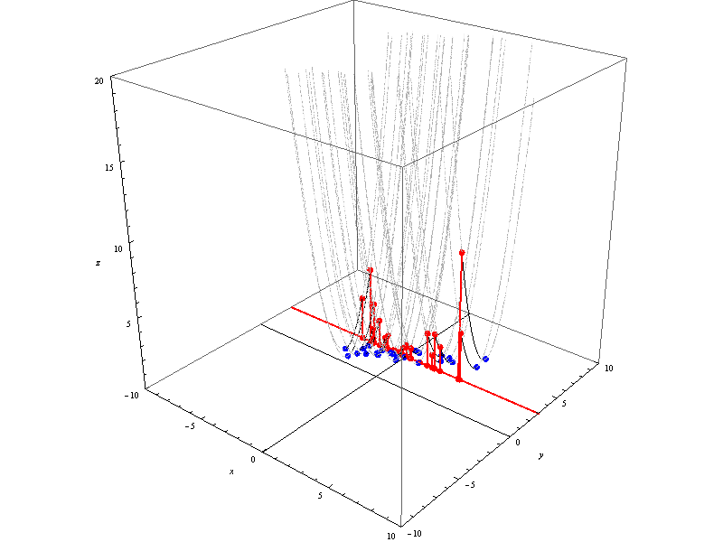
Linear Regression

Slide 43
Linear Regression

Slide 44
Minima: Scaled Variance & Covariance

Slide 45
Minima: Sum of Squared Differences & Sum of the Product of Differences

Slide 46
Linear Regression

Slide 47
Linear Regression
Slope: 0.543745
Mean: {-0.208094,2.98517}
Equation:

Slide 48
Independent Variable Bias

Slide 49
Independent Variable Bias

Slide 50
Online Mean

Slide 51
One Way To Program Simple Linear Regression
/*
Filename: main.cpp
To compile and run on linprog4.cs.fsu.edu: g++47 -o main.exe main.cpp -std=c++11 -O3 -Wall -Wextra -Werror -static && ./main.exe
*/
#include <iostream>
template <size_t n> std::ostream & operator << ( std::ostream & o, char const ( & c )[n] ) { for ( size_t i = 0; i < n - 1; ++i ) std::cout << c[ i ]; return o; }
template <typename T, size_t n > std::ostream & operator << ( std::ostream & o, T const ( & v )[n] ) {
auto i = std::begin( v ); auto end = std::end( v ); o << '{'; if ( i != end ) { o << *i; for ( ++i; i != end; ++i ) o << ',' << *i; } o << '}'; return o;
}
int main () {
using number = double;
enum dimensions { X, Y, DIMENSIONS };
number points[][ DIMENSIONS ]{
{-2.70238,2.43155}, {-2.18612,1.63634}, {0.405141,3.84976},{-1.03072,2.7144}, {1.10033,2.89639},
{-1.63906,2.56916}, {2.27983,4.57127}, {-0.836348,2.70824}, {-2.90988,0.685828}, {-0.104817,2.95222},
{-0.226538,2.24849}, {-2.64364,1.28981}, {-0.00953108,2.84022}, {0.336282,3.86626}, {4.12633,5.94993},
{1.70053,4.51368}, {-1.4793,1.99986}, {0.0467884,3.91811}, {-1.70285,2.12758}, {-3.61035,1.26436},
{2.08504,3.94459}, {4.23512,4.80965}, {2.70993,4.30984}, {-2.72741,1.97363}, {-0.418723,2.55797}
};
number mean[ DIMENSIONS ]{ 0 };
size_t n{ 1 };
for ( auto & point : points ) {
mean[ X ] = ( mean[ X ] * ( n - 1 ) + point[ X ] ) / n;
mean[ Y ] = ( mean[ Y ] * ( n - 1 ) + point[ Y ] ) / n;
++n;
}
std::cout << "mean: " << mean << '\n';
number residuals[ DIMENSIONS ]{ 0 };
number sum_of_product_of_differences_xy{ 0 };
number sum_of_squared_differences_xx{ 0 };
for ( auto & point : points ) {
residuals[ X ] = point[ X ] - mean[ X ];
residuals[ Y ] = point[ Y ] - mean[ Y ];
sum_of_product_of_differences_xy += residuals[ X ] * residuals[ Y ];
sum_of_squared_differences_xx += residuals[ X ] * residuals[ X ];
}
number w{ sum_of_product_of_differences_xy / sum_of_squared_differences_xx };
std::cout << "w: " << w << '\n';
number m{ w };
number b{ - w * mean[ X ] + mean[ Y ] };
std::cout << "y = " << m << " * x + " << b << '\n';
}

Slide 52
Conclusions
The sum of parabolas is a parabola.
Parabolas produce a global minima.
Parabolas can be used to produce Means and Linear Regressions from Variances and Covariances.
As presented, Linear Regression is biased toward the independent variable; moreover, the type of Linear Regression cannot produce a line that is straight up and down regardless of the data.
The Online Mean can be used to calculate the mean of an unknown amount of data or the mean of continuously generated data.

